Slide 1
Generative AI for Practitioners
Presented by Alexis Castellanos
Date: 08/23/2024
University of Michigan

Slide 2
Introductions
Over the past couple of months, we have witnessed the remarkable evolution of Generative AI. From composing intricate pieces of music to generating sophisticated designs and automating customer service responses, these advancements mark a significant step forward in AI technology, showcasing its potential to create immense value across various domains.
My name is Alexis Castellanos, and I am the Program Manager of Data Science. Today, I will provide an overview of Generative AI, specifically focusing on how this technology can be leveraged, common terminology and limitations .
Notes:
Thank you for the intro Paul. Hello my name is Alexis and I am the Program Manager of Data Science here at ISR. Today I will be providing an overview of Gen AI How we can use this technology in different fields Common terminology and limitations.
Over the past few months, there has been a remarkable evolution in Generative AI, demonstrating its potential across various domains. From composing music to automating customer service responses, these advancements showcase the progress in AI technology.
Today, I will provide an overview of Generative AI, focusing on how this technology can be leveraged effectively. We will delve into common terminology and explore the limitations of Generative AI.

Slide 3

Workshop Objectives
Purpose: The primary purpose of this workshop is to provide participants with a high-level introduction to generative AI, with a specific focus on transitioning from beginners to intermediate users of ChatGPT. The workshop aims to provide a solid understanding of core principles, effective prompting techniques, and practical skills for utilizing ChatGPT in various applications.
Demographic: This workshop is designed for professionals or students who rely on mathematical modeling and analysis. It caters to those with little to no prior experience with generative AI and ChatGPT, aiming to build their confidence and competence in using these technologies.
Outcome: By the end of the workshop, participants will:
Understand the core principles of generative AI and how ChatGPT works.
Master effective prompting techniques, including structuring and refining prompts.
Gain practical insights into strategic uses of ChatGPT in different fields.
Be aware of potential biases and limitations of AI and learn strategies to mitigate them.
Understand ethical considerations and best practices for responsible AI usage.
Be prepared to apply ChatGPT thoughtfully and effectively in their professional and personal endeavors.
Notes:
High-Level overview of Gen AI with a focus on ChatGPT
Why ChatGPT: Most accessible Gen AI model at the time.
This workshop is for new or into level users looking to integrate AI into daily tasks
At the end you will
*Be familiar with ChatGPT
*Knowledge of prompting techniques
*GPT Extensions
*Be aware of Limitations and Biases
*And Ethical considerations of AI Tools The workshop aims to equip professionals and students with an introduction to generative AI, focusing on transitioning from beginners to intermediate users of ChatGPT. It emphasizes understanding core principles, effective prompting techniques, and practical skills for ChatGPT applications. Designed for those with minimal prior experience in generative AI and ChatGPT, the workshop intends to boost confidence and competence in utilizing these technologies. By the workshop's end, participants will comprehend generative AI principles, master prompting techniques, gain insights on strategic ChatGPT applications, learn to identify biases and limitations in AI, understand ethical considerations in AI usage, and be ready to apply ChatGPT in their personal and professional pursuits.

Slide 4
Workshop Agenda
Introduction and Overview
Part 1: Understanding Generative AI and ChatGPT (1 hour)
Defining Gen AI
Basics of Prompting
Overview of ChatGPT
Part 2: Getting Started with ChatGPT (1 hour)
Understanding Hallucinations
Biases and Limitations
Structured Prompting
Part 3: Data Workflows with ChatGPT (1 hour)
Data Visualization
Data Modeling
Model Plug-Ins
Part 4: Practical Applications and Ethical Considerations (1 hour)
Prompting Frameworks
Ethical Considerations and Responsible Use
Future Trends and Q&A
Notes:
We have a four-part workshop today with a rough length of four hours. This workshop is broken up into the follwing parts: Part 1: AI definitions and Intro to ChatGPT Platform
Part 2: How to interact with LLMs (GPT)
Part 3: Advanced usage of GPT Part 4: Ethical Considerations and What's Next in AI In this workshop agenda, we will cover various aspects related to Generative AI and ChatGPT.
Part 1 focuses on understanding Generative AI and ChatGPT, starting with an introduction and overview, followed by exploring the basics of Generative AI and comparing it with other AI types. We will then delve into an overview of ChatGPT.
Moving on to Part 2, we will explore getting started with ChatGPT, including the basics of prompting and discussing common pitfalls and best practices to enhance usage.
Part 3 will cover advanced prompting techniques such as structured prompting, iterative prompting, and creative/strategic uses of ChatGPT.
Finally, in Part 4, we will discuss practical applications and ethical considerations related to ChatGPT, including case studies, ethical considerations for responsible use, and insights into future trends along with a Q&A session.

Slide 5
Part 1: Understanding Generative AI and ChatGPT
Key Concepts:
Learn to spot the differences between Gen AI and other AI Models
Understand interactions with ChatGPT
Overview of the ChatGPT Platform
Notes:
In this section, we will delve into the realm of Generative AI specifically focusing on ChatGPT. We will explore how Generative AI differs from other AI models, emphasizing the key distinctions. Additionally, we will examine the dynamics of interacting with ChatGPT and gain insights into the ChatGPT platform. By the end of this module, you will have a comprehensive understanding of the nuances of Generative AI and be equipped with the knowledge to navigate the ChatGPT environment efficiently. Let's dive deeper into the world of Generative AI and unleash the potential of ChatGPT together.

Slide 6
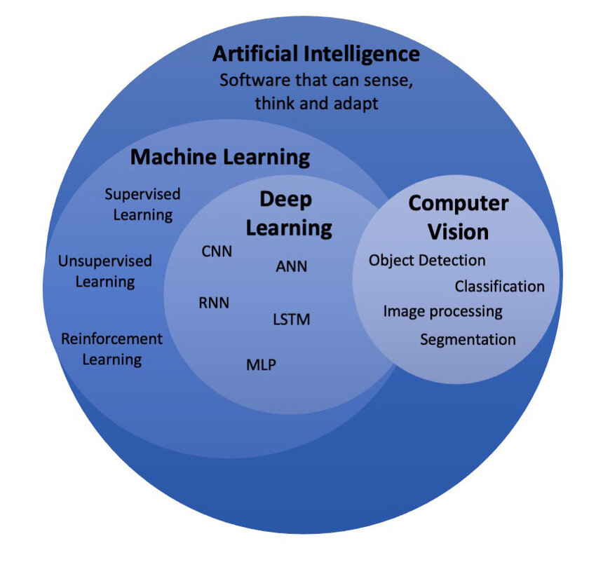
What is Artificial Intelligence?
Artificial Intelligence
Definition: AI is the theory and development of computer systems able to perform tasks normally requiring human intelligence.
Use case: Repetitive tasks
Notes:
Before diving into Gen AI, we need to understand that AI is a Field
Formal Definition Example: Automating payments or scheduling calendar reminders
Let's transition into the sub-field of Machine Learning Artificial Intelligence is a field focused on creating computer systems that can perform tasks requiring human-like intelligence.
One of the main applications of AI is in automating repetitive tasks that would typically be done by humans.
This technology has the potential to revolutionize various industries by streamlining operations and increasing efficiency through intelligent automation.
AI systems can process vast amounts of data quickly and accurately, making them valuable for tasks ranging from data analysis to autonomous decision-making.

Slide 7
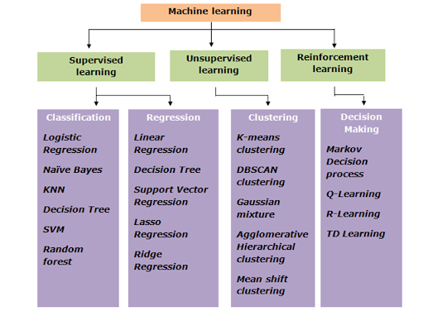
What is Machine Learning ?
Machine Learning
Definition: Machine Learning (ML) is a subset of artificial intelligence that involves developing algorithms enabling computers to learn from and make predictions based on data. It uses methods like supervised, unsupervised, and reinforcement learning to identify patterns and make decisions without explicit programming.
Use case: Predictive Analytics: Forecasting sales, stock prices, or customer behavior.
Image and Video Analysis: Facial recognition, medical imaging diagnostics, and autonomous driving.
Anomaly Detection: Fraud detection in financial transactions and network security monitoring.
Source
Notes:
AI: Automates Repetitive Task
ML difference is that
it Does not need to be explicitly programed. Meaning it can identify patterns and trends based on data.
Use cases:
Forecasting Sales
Facial Recognition (Unlock your phone)
Fraud detection
Autonomous driving
Moving into a sub-filed of machine learning is Deep Learn Machine Learning is a subset of artificial intelligence that focuses on developing algorithms for computers to learn from data and make predictions. It utilizes supervised, unsupervised, and reinforcement learning methods to identify patterns and make decisions autonomously.
Key use cases of Machine Learning include Predictive Analytics for forecasting sales, stock prices, and customer behavior. Additionally, it is used in Image and Video Analysis for tasks like facial recognition, medical imaging diagnostics, and autonomous driving.
Another critical application is Anomaly Detection, used in detecting fraud in financial transactions and monitoring network security for unusual activities.

Slide 8
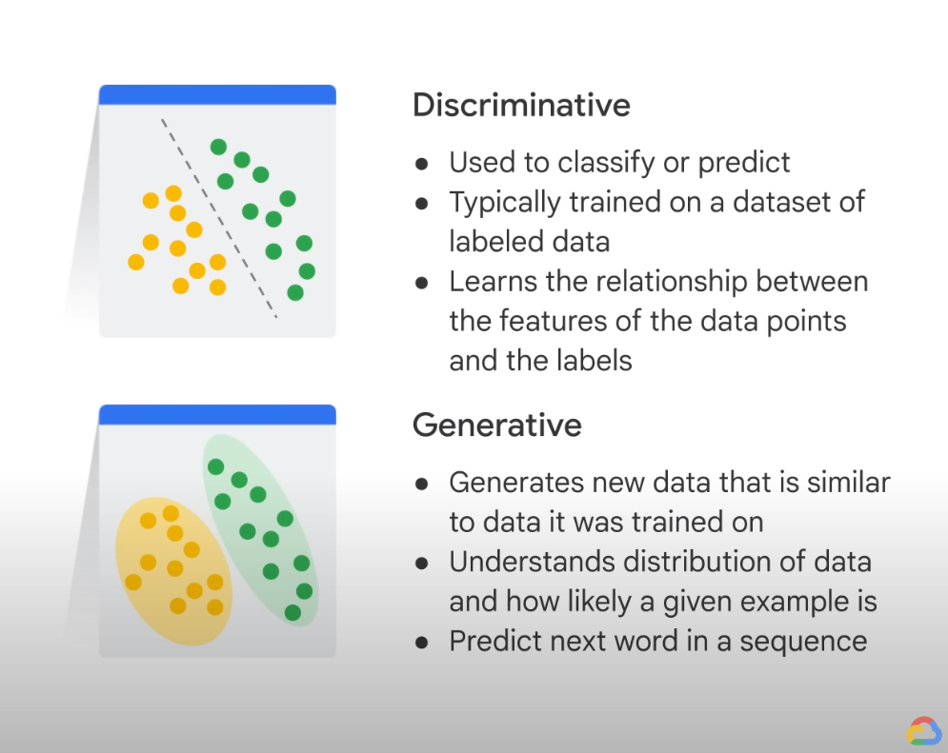
Introduction to Deep Learning
Deep Learning
Definition: Deep Learning is a subset of machine learning that involves algorithms inspired by the structure and function of the brain's neural networks. It uses multiple layers of artificial neurons to model and understand complex patterns in large datasets, enabling tasks such as image and speech recognition, natural language processing, and autonomous driving.
Use case: Natural evolution of classical machine learning techniques.
Notes:
Deep learning is partially inspired on how we think the human brain works. Hence the popular architecture name Neural Networks
Discriminative: Similar to what we saw from Machine Learning
Generative is focused on creating new instances based on training data.
Deep Learning is a subset of machine learning inspired by neural networks in the brain. Multiple layers of artificial neurons analyze large datasets for tasks like image recognition and autonomous driving. This technology represents a natural progression from traditional machine learning methods.

Slide 9

Basics of Generative AI
Generative AI
Definition: Generative AI refers to a category of artificial intelligence algorithms that generate new data or content that is similar to the input data they have been trained on. These algorithms can create text, images, music, and other types of content. [prompt]
Core Idea: Gen AI is to learn patterns from existing data and use that knowledge to generate new instances that resemble the training data.
Notes:
As mentioned before, the core Idea of Gen AI is to learn patterns from existing data and use that knowledge to generate new instances that resemble the training data.
For example, the provided definition of Gen AI was used to generate the image you see on this slide.
Generative AI involves artificial intelligence algorithms that can create new data or content similar to what they are trained on, including text, images, and music. The core idea of Generative AI is to learn patterns from existing data and use that knowledge to generate new instances that resemble the training data. This technology has vast potential in fields such as creative arts, data synthesis, and content generation. It represents a paradigm shift in how machines can autonomously create content, opening up new possibilities for innovation and productivity. Understanding the capabilities and limitations of Generative AI is crucial for harnessing its power effectively.

Slide 10
Types of AI [Summary]
Other Types of AI:
Purpose: Analyze data, make decisions, automate tasks
Functionality: Recognizes patterns, predicts outcomes, optimizes processes
Examples:
Predictive AI: Forecasting sales, weather predictions
Analytical AI: Image recognition, speech-to-text
Reactive AI: Self-driving cars, recommendation systems
Applications: Healthcare diagnostics, financial modeling, customer service
Generative AI:
Purpose: Create new data similar to existing data
Functionality: Generates text, images, music, and more
Examples:
Text: GPT-4 (ChatGPT)
Images: DALL-E
Music: MuseNet
Applications: Content creation, design, entertainment, drug discovery
Key Differences:
Output:
Generative AI: Creates new, original content
Other AI: Analyzes and interprets existing data
Focus:
Generative AI: Innovation and creativity
Other AI: Efficiency and accuracy
Notes:
Other types of AI focus on: Automation Prediction or Forecasting Labeling or Classification
Or Clustering
When Gen AI focuses on creation or generation to a particular field.
Generative AI focuses on innovation and creativity by creating new data similar to existing data across text, images, music, and more. Examples include GPT-4 (ChatGPT), DALL-E, and MuseNet used in content creation, design, entertainment, and drug discovery. It differs from other AI types in that it generates original content instead of analyzing existing data. Other AI types, like Predictive AI, Analytical AI, and Reactive AI, are designed to analyze data, make decisions, and automate tasks such as forecasting sales, image recognition, and self-driving cars. These AI applications are crucial in various fields like healthcare diagnostics, financial modeling, and customer service.

Slide 11
Applications of Generative AI
Text Generation: Models like GPT-4 can generate coherent and contextually relevant text, which is useful for tasks such as writing assistance, content creation, and chatbots.
Image Generation: GANs can create realistic images from noise or from textual descriptions, enabling applications in art, design, and virtual reality.
Music Composition: Generative AI can compose music by learning patterns from existing compositions and generating new pieces that mimic those styles.
Data Augmentation: Generative models can create synthetic data to augment training datasets, which is particularly useful in scenarios where data is scarce or expensive to obtain.
Creative Applications: Artists and designers use generative AI to explore new creative possibilities, generating novel artwork, designs, and animations.
Notes:
Some of the most common fields Gen AI is used for are: Creative Applications: Like photoshop
Data Augmentation: CTGANS for Data
Music Generation Image Generation: Dalle
Text Generation
Applications of Generative AI span across various industries and sectors, demonstrating the versatility and potential of this technology in creating innovative solutions and enhancing existing processes.
Generative AI has been utilized in fields such as healthcare, finance, and art to generate realistic imagery, assist in medical diagnoses, predict market trends, and even generate creative content.
The capabilities of Generative AI continue to expand, offering opportunities for automation, personalization, and efficiency improvements in a wide range of applications, showcasing the ongoing evolution and impact of artificial intelligence in shaping the future.

Slide 12
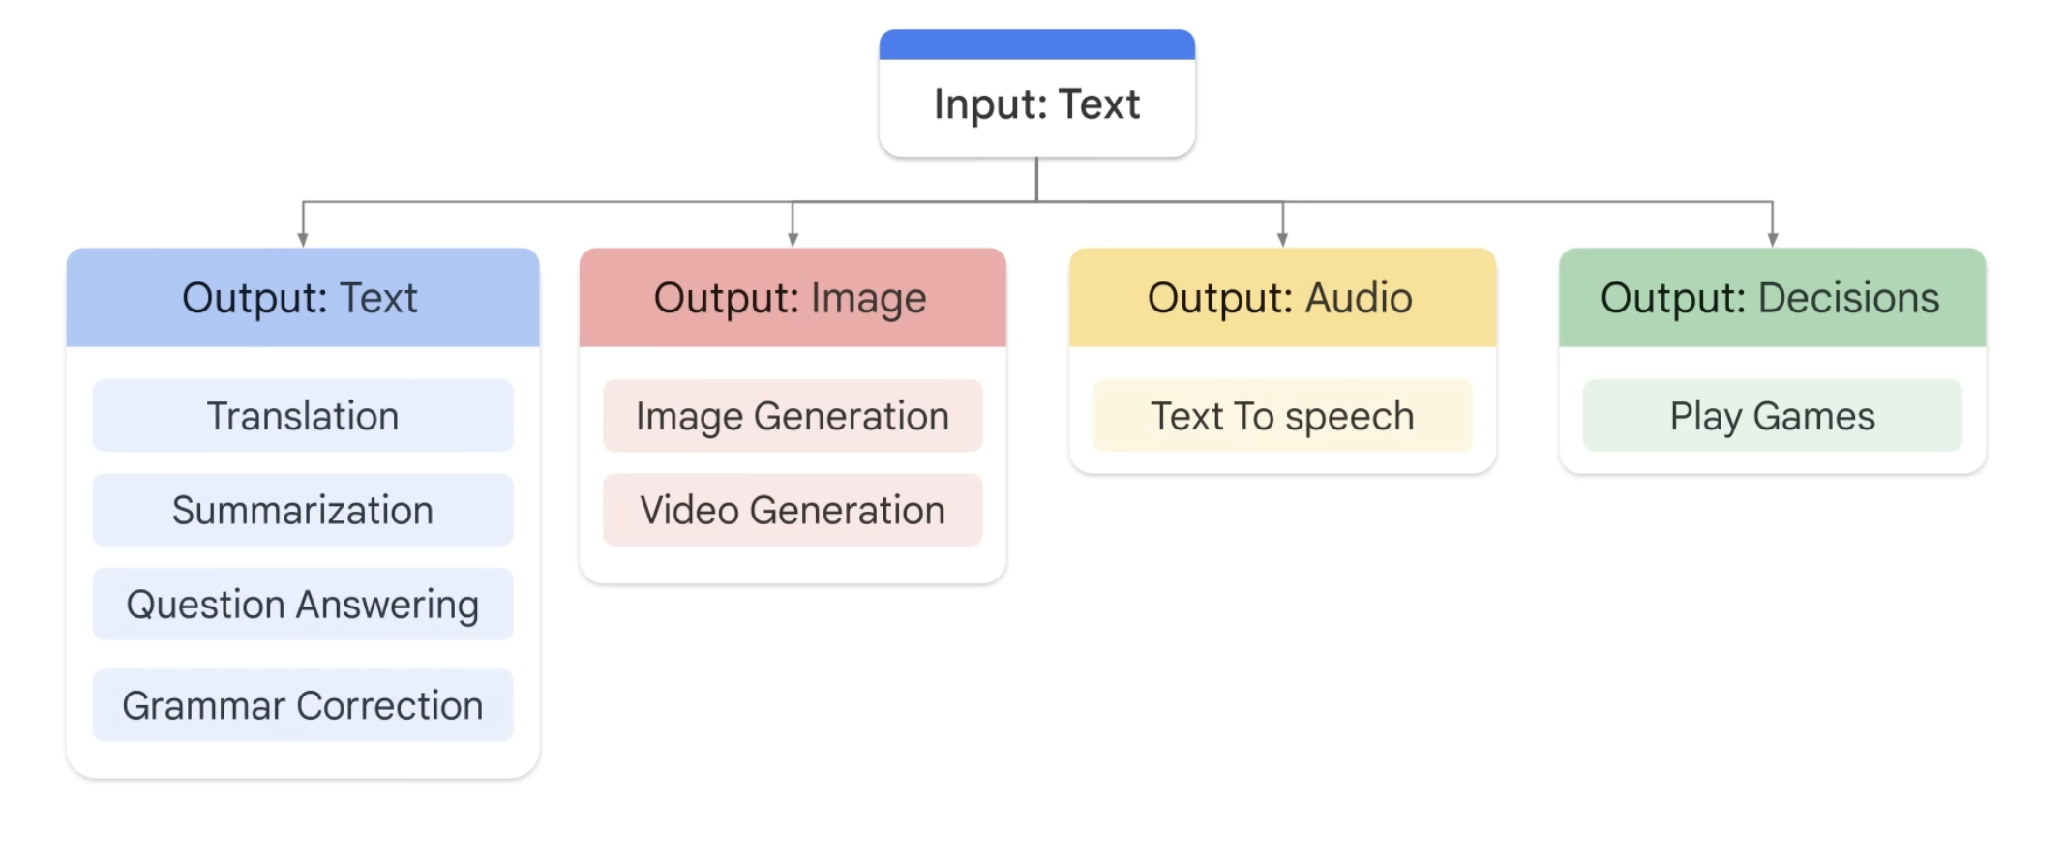
Generative AI- Large Language Models [General Interactions]
Notes:
Since our main focus today is chatGPT we will need to mention this is an LLM. LLMs work by us providing input text Input text is then used to create our desired output
It could be text, audio, images, videos or even decisions
Large language models in generative AI have the potential to revolutionize various aspects of human interactions, offering new ways to communicate and engage with technology. These advanced models are capable of understanding context, generating human-like text, and responding to queries with impressive accuracy
Their applications span across a wide range of fields such as customer service, content creation, and even virtual assistants, providing users with personalized and efficient interactions. Leveraging the power of generative AI can enhance user experiences, streamline communication processes, and drive innovation in the digital landscape
By exploring the capabilities of large language models in general interactions, organizations can unlock opportunities to create more engaging content, improve customer satisfaction, and build stronger connections with their audience. Understanding the nuances of generative AI and its impact on language processing can pave the way for exciting advancements in how humans interact with technology

Slide 13
Introduction to ChatGPT [Overview]
What is ChatGPT?
Full Name: Chat Generative Pre-trained Transformer
Developed by: OpenAI
Architecture: Based on GPT-4
Functionality: Generates human-like text from input prompts
Accessibility: Web UI, Mobile & Desktop Applications, API [Paid]
How ChatGPT Works:
Pre-training: Trained on diverse internet text.
Fine-tuning: Refined with human-reviewed datasets.
Interaction: Generates context-aware text responses.
Applications of ChatGPT:
Customer Support: Instant responses, automated help desks
Content Creation: Drafting emails, articles, creative writing
Entertainment: Game NPCs, interactive storytelling
Research: Data analysis, idea generation
Education: Tutoring, homework help
Business: Market research, internal communications
Benefits of ChatGPT:
Efficiency: Automates tasks, enhances productivity
Scalability: Manages multiple interactions
Accessibility: Available anytime, anywhere
Notes:
I have mentioned chatGPT multiple times now,
but let's give a brief overview for those who are not familiar.
ChatGPT is owned by OpenAI and OpenAI was aquired by company Microsoft recently. The GPT models generate human like text from input prompts.
You can access GPT by Web UI, applications or API
ChatGPT is a powerful tool developed by OpenAI that generates human-like text responses based on input prompts.
It operates through pre-training on diverse internet text, fine-tuning with human-reviewed datasets, and context-aware text generation.
Applications span customer support, content creation, entertainment, research, education, and business use, offering benefits like task automation, scalability, and accessibility anytime, anywhere.

Slide 14
Getting Start with OpenAI’s GPT [Create an Account]
Step 1: Visit the OpenAI Website
Open your web browser and navigate to the OpenAI website.
Step 2: Sign Up
On the OpenAI homepage, look for the "Sign Up" or "Get Started" button and click on it.
Step 3: Provide Email and Create Password
Enter your email address and create a password for your account. Alternatively, you can sign up using your Google account if that option is available.
Step 4: Verify Email
Open the email account you used to sign up and look for a verification email from OpenAI. Click on the verification link in the email to confirm your account.
Step 5: Complete Profile
Return to the OpenAI website and log in with your new account. You may be prompted to complete your profile by providing additional information such as your name, organization, and contact details.
Step 6: Choose a Plan
Select a subscription plan that fits your needs. OpenAI offers different tiers of service, from free trials to various paid plans with different levels of access and usage limits.
Step 7: Enter Payment Information
If you choose a paid plan, you will need to enter your payment information. Follow the prompts to provide your credit card or other payment details.
Step 8: Read and Accept Terms
Read through the terms of service and privacy policy. Make sure you understand and agree to these terms, then accept them to proceed.
Step 9: Access the API
Once your account is set up and your plan is active, you can start using the GPT-3 API. You will find API keys and documentation in your account dashboard.
Step 10: Explore Documentation and Resources
Familiarize yourself with the API by exploring the documentation and other resources provided by OpenAI. This will help you understand how to integrate and use the GPT-3 capabilities in your applications.
Notes:
If you don’t already have an account, let’s take a couple of minutes to create one.

Slide 15
GPT-4 Example [Interactive]
Using ChatGPT with the Whimsical Diagram plug-in, generate the following diagram: [https://chatgpt.com] Create a chart that outlines the field of AI. Include all possible sub fields and examples of models.
Notes:
Explain the fundamental theory of calculous Now explain it like I am 5
Explain Gen AI to me as if I was 5.
Create a mind map that outlines the field of AI. Include all possible sub fields and examples of models.

Slide 16
Prompting Definition [Post-Interaction]
What did we just do? We interacted with a generative model via a “Prompt”.
In the context of GPTs (Generative Pre-trained Transformers), a prompt is a piece of text input provided by the user to the model to generate a desired output. The prompt serves as the initial context or seed from which the model begins its text generation process. Here’s a detailed breakdown:
Input Text: The prompt is the text that you type into the model to initiate the response. It can be a question, a statement, a set of instructions, or any other form of textual input.
Context Provider: The prompt sets the context for the generated response. The model uses the prompt to understand the topic, tone, and style of the text it needs to generate. For example, a prompt asking for a summary of a scientific article will generate a different type of response than a prompt asking for a creative story.
Influence on Output: The length and specificity of the prompt can significantly influence the quality and relevance of the generated output. A well-crafted prompt provides clear and concise information, guiding the model to produce more accurate and relevant responses.
Dynamic Interaction: In interactive applications, users may refine prompts iteratively, using the model's responses to adjust their queries and get more targeted results. This interaction can help in fine-tuning the generated content to better meet user needs.
Notes:
What did we just do? We interacted with a GPT model using input text. This is what we call prompting. Your prompt is crucial because it provides the model context on the task, it can influence the overall structure and you may interact back and fourth reach the desired output.
In the context of GPTs (Generative Pre-trained Transformers), a prompt is a critical tool for users to interact with the model and guide the text generation process.
The prompt serves as the initial context or seed, shaping the generated response based on the input text provided.
The length and specificity of the prompt play a crucial role in determining the quality and relevance of the model's output.
Users can engage in dynamic interaction by refining prompts iteratively, leveraging the model's responses to fine-tune their queries for more targeted results.

Slide 17
Intro to Prompting [Zero-Shot]
Zero-Shot Prompting
Definition: Zero-shot prompting is a technique in NLP where a model is given a task or query without any specific examples or training data for that task.
Key Features:
Relies on Pre-existing Knowledge: Utilizes the model's broad knowledge base built from extensive training.
No Specific Training Examples: Unlike few-shot or many-shot prompting, zero-shot requires no prior examples for the task.
Applications:
Question Answering: Answering questions about topics without specific training, e.g., "What is the capital of France?" (Answer: Paris).
Text Generation: Creating stories or articles on given topics without examples.
Translation: Translating sentences between languages without explicit training on that language pair.
Classification: Categorizing text into predefined categories without specific training data, e.g., sentiment analysis of movie reviews.
Benefits:
Flexibility: Capable of handling a wide range of tasks.
Adaptability: Performs well even in new, unseen situations.
chatgpt.com
Notes:
Zero-shot prompting in NLP involves giving a model a task or query without specific examples or training data. It relies on the model's pre-existing knowledge base and requires no prior training examples. Applications include question answering, text generation, translation, and classification tasks like sentiment analysis. The technique offers flexibility and adaptability, capable of handling a wide range of tasks and performing well in new, unseen situations. Zero-shot prompting showcases the model's ability to leverage existing knowledge effectively without the need for task-specific training data.
The most fundamental technique is Zero-shot prompting.
It relies on the model's pre-existing knowledge.
We can ask it a question on a fact, like a search engine:
PROMPT: Who's the US president
We can translate language:
PROMPT: Translate the following phrase: "Más vale tarde que nunca”
You do not need to mention the source language
We could request a description of an image: https://www.freepik.com/premium-vector/cute-panda-drink-coffee-icon-illustration-panda-cup-coffee-animal-icon-concept-isolated_7833610.htm
If you are using the mobile app, GPT will recognize objects, landmarks and much more.
Moving into generate text on a subject:
PROMPT: Write an article on the current state of AI.
We could even ask it for sentiment or interpretation of text: Given the following movie review, interpret the sentiment and provide me with a score from 1 to 5 stars:

Slide 18

Improve Your Prompts [Be Specific]
Stylize
Simple
Technical
Formal
Informal
Persuasive
Creative
Format
Summary
Bullet Points
Headings & Subheadings
Table(s)
Text File
Restrict
One Sentence
One Paragraph
Extremely Detailed
Use the Open Web
Sources between 2020-2022
chatgpt.com
Notes:
Goofy
Prompt: Provide me with a pirate rhyme, in a poem format with 9 lines about birds.
Practical Example
Prompt: Explain Generative AI like I am 5 years old, in bullet points within 10 sentences.

Slide 19
Stylization [Role Prompting]
Role Prompting
Definition: Role prompting is a technique where a model is assigned a specific role or persona to guide its responses, ensuring they are contextually relevant and appropriate.
Key Features:
Assigned Role or Persona: Influences the model's responses.
Guided Output: Provides context and direction.
Enhanced Interaction: Makes interactions more engaging and accurate.
Applications:
Customer Support:
Role: Customer Support Agent
Prompt: "As a customer support agent, help the customer troubleshoot their internet connectivity issue."
Response: "Hello! I'm here to help you with your internet connectivity issue. Can you please restart your router and let me know if the issue persists?"
Educational Tutor:
Role: Math Tutor
Prompt: "As a math tutor, explain the Pythagorean theorem to a high school student."
Response: "Sure! The Pythagorean theorem states that in a right-angled triangle, the square of the length of the hypotenuse is equal to the sum of the squares of the lengths of the other two sides. This can be written as a^2+b^2=c^2."
Content Creator:
Role: Travel Blogger
Prompt: "As a travel blogger, write a short paragraph about your recent trip to Paris."
Response: "Paris, the city of lights, never fails to enchant. From strolling along the Seine to marveling at the Eiffel Tower, every corner of the city is steeped in history and romance. The quaint cafes, the stunning architecture, and the vibrant art scene make Paris a dream destination for travelers."
Medical Professional:
Role: Doctor
Prompt: "As a doctor, explain the importance of vaccination to a concerned parent."
Response: "Vaccinations are crucial for protecting your child and the community from serious diseases. They work by stimulating the immune system to recognize and fight specific infections, reducing the risk of illness and preventing the spread of contagious diseases. Vaccines are thoroughly tested for safety and effectiveness, and they play a key role in maintaining public health."
chatgpt.com
Notes:
Role prompting will make create GPT to be a "mock" of whatever you wish. Prompt 1: Your goal is to assist a customer who is experiencing issues with their recently purchased smartphone. The customer is frustrated due to a recurring software glitch that causes the phone to freeze. Respond in a calm and empathetic manner, guiding them through the troubleshooting process and offering to escalate the issue to a technical specialist if needed. Ensure that the customer feels heard and supported throughout the interaction. Prompt2: "You are a customer support agent for an e-commerce platform that specializes in selling high-end electronics. Your goal is to assist a customer who is experiencing issues with their recently purchased smartphone. The customer is frustrated due to a recurring software glitch that causes the phone to freeze. Respond in a calm and empathetic manner, guiding them through the troubleshooting process and offering to escalate the issue to a technical specialist if needed. Ensure that the customer feels heard and supported throughout the interaction.”
Prompt 3: You also are Dr. Seuss working as customer support. Your goal is to assist a customer who is experiencing issues with their recently purchased smartphone. The customer is frustrated due to a recurring software glitch that causes the phone to freeze. Respond in a calm and empathetic manner, guiding them through the troubleshooting process and offering to escalate the issue to a technical specialist if needed. Ensure that the customer feels heard and supported throughout the interaction."

Slide 20
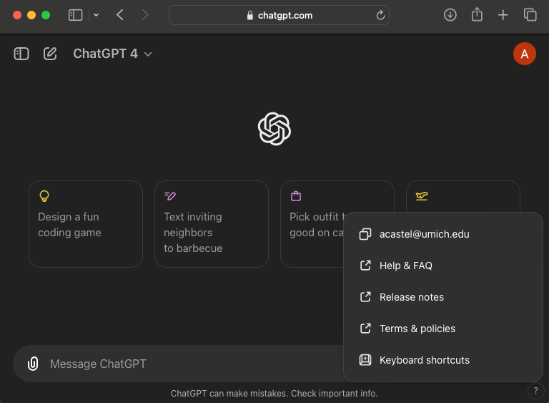
ChatGPT Platform [Interface]
Choosing a Model:
GPT-4o: Complex Task
GPT-4o mini: Quick response rate, lower complexity
GPT-4: Legacy Model
GPT Chats:
Edit Prompt & Compare
Rename
Achieve
Share
Delete
chatgpt.com

Slide 21
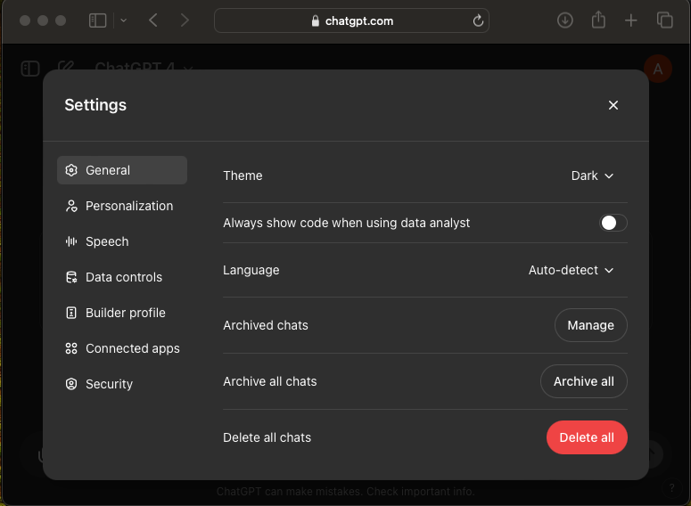
ChatGPT Platform [Settings Overview]
Important Settings
General- Manage your GPT Chats Data Controls- Improve the model for everyone allows OpenAI to use your data.
Connected Apps- Allows GPT to connect to Google Drive and Microsoft One Drive
Personalization- Allows GPT to use custom instructions
chatgpt.com
Notes:
Browsing: Top 5 Finance stories this month
DALL*E: A tent with a campfire outside in the mountains on a beautiful night with the Milky Way in the night sky. Code: Write a python linear regression function. Now try different langauges

Slide 22
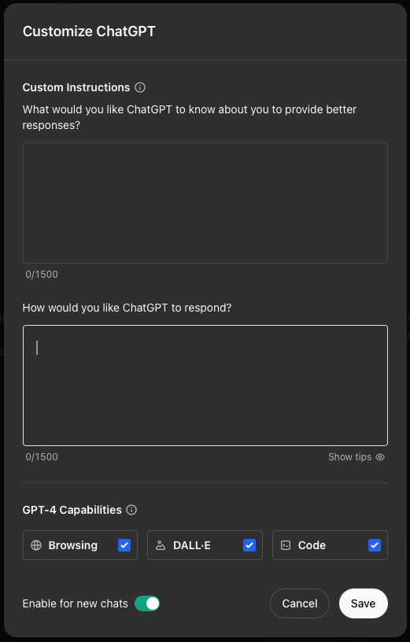
ChatGPT Platform [Customize ChatGPT]
Important Settings
Custom Instruction Tips:
ChatGPT Response Tips:
chatgpt.com
Notes:
My custom settings: Current based in Ann Arbor Michigan, employed by University of Michigan.
My hobbies are programing (mainly python), creating machine and deep learning models. My goal is to be as efficient and effective at my work as a data scientist with some software engineering skills. ChatGPT should be formal with a knowledge base to complement my work as a data scientist. GPT should be able to provide ideas and help troubleshoot technical issues. I expect code generation written to optimize for run-time.

Slide 23
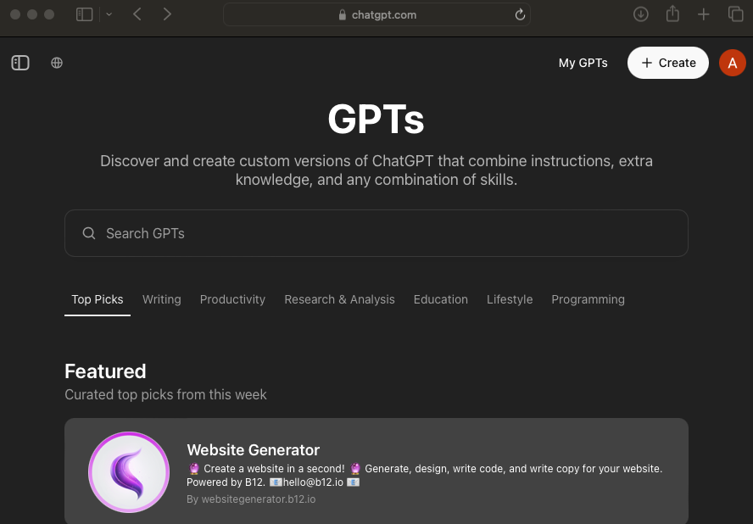
ChatGPT Functions [Custom GPTs]
Important Settings
Search Custom GPTs
Call GPTs in Conversations
Build your own GPT
chatgpt.com
Notes:
You might have seen GPT have the ability to generate images, graph.
Search: Whimsical Mind Maps
Call: Explain the field of AI and it's subfields. Then create a mind-map and provide example models.
Image Generator: Provide to me a picture of a golden retriever sipping on coffee. Build: Create a coloring book of domestic cat breeds Show Creation, Configure, Demonstration Brief coverage of Knowledge and Actions. Beyond the scope of this workshop
Browsing: Top 5 Finance stories this month
DALL*E: A tent with a campfire outside in the mountains on a beautiful night with the Milky Way in the night sky. Code: Write a python linear regression function.

Slide 24

Real-World Benefits and Challenges
Benefits:
Creativity and Innovation: Generative AI opens new possibilities for creative work by providing tools to generate novel content.
Efficiency: It can automate content creation processes, saving time and resources.
Personalization: Generative models can create personalized content tailored to individual preferences and needs.
Challenges:
Quality Control: Ensuring the quality and reliability of generated content can be difficult.
Ethical Concerns: The use of generative AI raises ethical issues, such as the potential for generating misleading or harmful content.
Data Privacy: Using sensitive data to train generative models can pose privacy risks.
Notes:
Generative AI brings numerous benefits in the real world, offering new avenues for creativity and innovation through the generation of unique content. It also enhances efficiency by automating content creation processes, thereby saving valuable time and resources. Another advantage is the ability to personalize content based on individual preferences and needs. However, challenges exist in maintaining quality control of the generated content, ensuring its reliability. Ethical concerns arise concerning the use of generative AI, particularly in the potential generation of misleading or harmful content. Additionally, there are data privacy risks associated with utilizing sensitive data to train generative models.

Slide 25

Part 2 Prompting for LLMs
Key Concepts:
Repeating or Reasoning
Hallucinations and Biases
Prompt Techniques
Notes:
Welcome back
In this section, we will be covering approaches to prompting for LLMs
Key take-ways for this section are the following:
Are models simply repeating or is there reasoning ?
Understanding hallucinations and biases
Prompting techniques mitigate these the current pitfalls

Slide 26

What is the Stochastic Parrot?
Understanding "Stochastic Parrot"
Stochastic: Essentially means random, derived from mathematical terminology.
Parrot: Known for repeating what they’ve heard without understanding.
Stochastic Parrot in AI: Refers to AI models like ChatGPT that are perceived as randomly regurgitating information without true comprehension. [prompt]
Origin of the Term "Stochastic Parrot"
Key Paper: "On the Dangers of Stochastic Parrots: Can Language Models Be Too Big?" (2021)
Main Claims:
Language models consume significant energy.
They are prone to bias.
They might negatively impact certain groups.
Key Focus: Whether these models truly understand language or merely mimic it.
chatgpt.com
Notes:
The term 'Stochastic Parrot' in AI refers to models like ChatGPT that seem to randomly regurgitate information without true understanding. This concept combines 'stochastic,' meaning random in mathematical contexts, and 'parrot,' known for imitating without comprehension. The origin of this term can be traced to a key paper discussing the risks associated with large language models like ChatGPT. The paper raises concerns about the energy consumption, bias, and potential negative impacts on specific groups by these models. It questions whether these models genuinely comprehend language or simply mimic it.

Slide 27
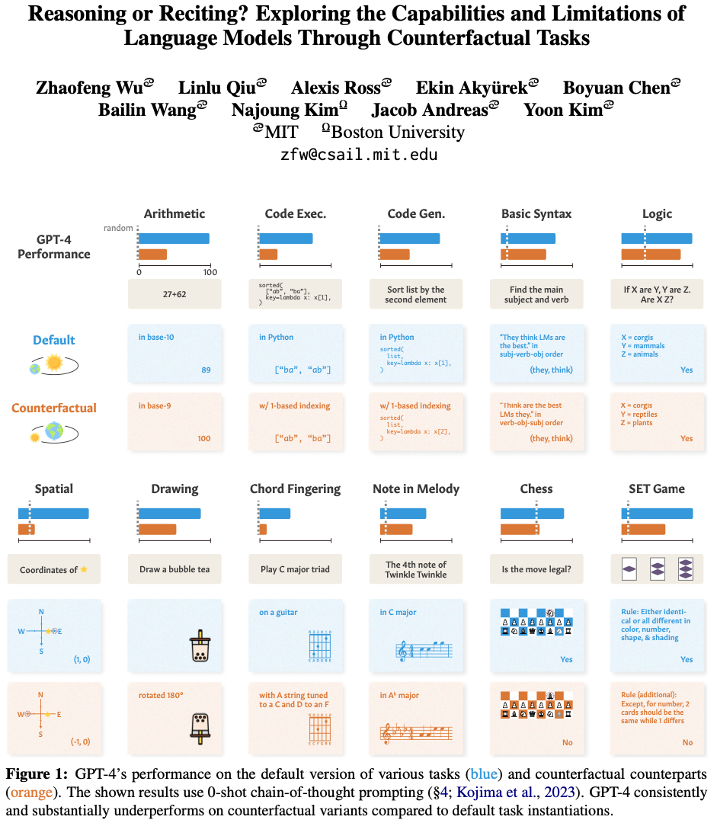
Abstract Reasoning ?
The paper "Reasoning or Reciting? Exploring the Capabilities and Limitations of Language Models Through Counterfactual Tasks" investigates the reasoning abilities of large language models (LLMs) by subjecting them to a series of counterfactual tasks. These tasks are designed to deviate from standard assumptions underlying conventional tasks, thereby testing whether LLMs can adapt to new, non-standard conditions or if they merely rely on memorized patterns.
Key findings of the study include:
Counterfactual Task Framework: The authors propose a novel evaluation framework that introduces "counterfactual" variants of standard tasks. These variants alter the default conditions of tasks to assess whether LLMs can reason abstractly or if their performance is dependent on the specific data seen during pretraining.
Performance Degradation: Across a suite of 11 tasks, the study found that while LLMs can handle some counterfactual tasks to an extent, their performance generally degrades significantly when compared to the default conditions. This suggests that the models rely heavily on narrow, non-transferable task-solving procedures rather than general reasoning abilities.
Task Examples:
Arithmetic: The study evaluates LLMs on basic arithmetic tasks using different numerical bases (e.g., base-8, base-9, etc.), demonstrating that performance drops when models are tasked with less familiar numerical systems.
Programming: Another experiment involved asking LLMs to generate or evaluate code in a fictional programming language, “ThonPy,” which differs from Python only by using 1-based indexing. The results showed that LLMs often struggled with these unfamiliar conditions.
Natural Language Reasoning: The study also explored the logical reasoning capabilities of LLMs through tasks that manipulate natural language premises, finding that the models struggled when presented with premises that violate common sense.
Implications: The study's results suggest that while LLMs appear to possess abstract reasoning skills, these are often task-specific and may not generalize well to novel scenarios. This highlights the need for more careful interpretation of LLM performance and suggests directions for future research aimed at improving the generality and robustness of these models.
The findings emphasize the importance of distinguishing between true reasoning capabilities and the recitation of learned patterns when evaluating the performance of LLMs​ (ar5iv)​ (ACL Anthology)​ (ar5iv).
chatgpt.com
Notes:
The study investigates the reasoning capabilities of large language models (LLMs) through counterfactual tasks, testing their ability to adapt to new, non-standard conditions.
Key findings include the introduction of a novel evaluation framework for counterfactual task variants, revealing that LLMs rely heavily on specific task-solving procedures rather than general reasoning abilities.
Performance degradation is observed across various tasks, indicating that LLMs struggle significantly when faced with altered task conditions, highlighting the limitations of their reasoning capabilities.
Task examples such as arithmetic, programming, and natural language reasoning demonstrate LLMs' challenges in handling unfamiliar scenarios, underscoring the importance of careful interpretation of their performance and the need for future research to enhance their generality and robustness.

Slide 28
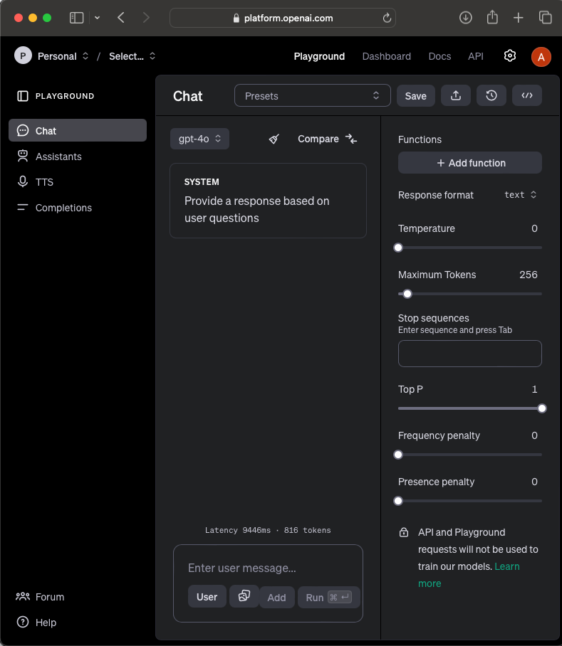
What is model temperature?
GPT Playground
Model Temperature
Temperature in AI Models: Adjusting the temperature of a model affects the randomness of its output.
Low Temperature (0): The model gives high-probability, straightforward answers.
High Temperature (up to 2): The output becomes more random and less coherent, demonstrating the "stochastic" nature of the model.
chatgpt.com
Notes:
Temperature controls the deterministic behavior of the model
When we talk about model temperature in the context of AI models, we are referring to the adjustment of the temperature which influences the randomness of the model's output.
Low temperatures, at 0, lead to the model providing high-probability and direct responses. On the other hand, higher temperatures, going up to 2, result in more random and less coherent outputs, showcasing the stochastic nature of the model.
Understanding the impact of temperature adjustments on model behavior is crucial in AI development and can significantly affect the output generated.
Visit GPT Playground at chatgpt.com to explore and interact with AI models for various applications.

Slide 29

Introduction to Hallucinations in Language Models
What is a Hallucination?
Definition: Hallucinations occur when a language model outputs something inaccurate or incorrect. Some argue "confabulation" is more accurate, but "hallucination" is widely accepted.
Debate on Hallucinations:
Creativity vs. Reliability: While some argue hallucinations foster creativity, most business users seek to minimize them for reliability.
Practical Impact: In critical applications like healthcare or legal contexts, hallucinations can lead to significant errors, making their reduction crucial.
Future Outlook: OpenAI aims to reduce hallucinations, but some experts argue this issue may be inherent to the technology.
chatgpt.com
Notes:
This is why tunning for business use cases is critical. Generative AI is not AGI behavior.
Hallucinations in language models refer to inaccuracies or errors in generated output. Some prefer the term 'confabulation' over 'hallucination,' but the latter is more commonly used. A debate exists on whether hallucinations enhance creativity or hinder reliability; for many business users, reducing them is crucial. In critical fields like healthcare or legal contexts, hallucinations can have severe consequences, necessitating their minimization. OpenAI is working to address hallucination issues, but some experts believe this challenge may be inherent to the technology.

Slide 30
Why Do Models Hallucinate?
Lack of "I Don't Know": Models often guess instead of admitting they don't know due to training on internet-scale data.
Internalizing False Information: Models can absorb and output incorrect or biased information from the internet.
Sycophancy: Models may provide answers they think the user wants, not the truth, especially when trained with reinforcement learning from human feedback (RLHF).Context-Specific Sycophancy: The manifestation of sycophancy can vary depending on the context (e.g., chatbots vs. business applications).
Inability to Backtrack: Models struggle to revise answers and may vary responses based on settings like temperature.
Limited Real-World Grounding: Current models have limited understanding of real-world contexts, but future training on multimodal data may improve this.
chatgpt.com
Notes:
Models may provide inaccurate information due to their training on vast amounts of internet data which leads to guessing when uncertain.
Models possess the capability to internalize and reproduce false or biased data that they encounter online.
Model responses can lean towards what the user wants instead of the factual truth, especially when trained with human feedback through reinforcement learning.
The adaptability of models to exhibit sycophancy varies with the specific context, such as chatbots versus business applications.
Models have difficulty correcting mistakes or revising answers, often resulting in inconsistent responses influenced by settings like temperature.
Current models lack a deep understanding of real-world situations but could enhance this through training on data encompassing multiple senses in the future.

Slide 31
Practical Methods to Reduce Hallucinations
Give the Model an Out: Prompt the model to answer only if it knows the answer, otherwise instruct it to say, "I don't know.”
Example 1: Give me information regarding the heaviest hippo ever recorded.
Example 2: Who is the USA president ?
Be Cautious with Long Contexts: Models are prone to hallucinations in the middle portions of long documents or conversations.
Use Formal Language: Using structured and correct language in prompts reduces the incidence of hallucinations across various models.
Example: Formal prompts like “Please summarize the key findings of the latest research on climate change” lead to more accurate outputs.
Ongoing Evaluation: Regular evaluation and fine-tuning of models can help monitor and reduce hallucinations over time.
chatgpt.com
Notes:
Cover the two examples.
When working with models, prompt them to answer only if they are confident, otherwise, encourage them to respond with 'I don't know.'
Models are more likely to have hallucinations in the middle parts of long documents or conversations, so be cautious with extended contexts.
Utilizing formal language in prompts can help reduce hallucinations; for instance, asking for a summary of recent climate change research yields more accurate results.
Regularly evaluating and adjusting models can effectively monitor and decrease hallucinations over time.

Slide 32
Challenges Beyond Hallucinations: Addressing Biases
Overview of Biases: Language models can exhibit gender, cognitive, geographic, and language biases, affecting their outputs.
Gender Bias: Defaulting to stereotypes, e.g., assuming a nurse is female.
Cognitive Bias: Favoring the first option presented in evaluations.
Geographic Bias: Reflecting the biases of populations from dominant regions.
Language Bias: Higher error rates in low-resource languages.
RLHF and Bias: Reinforcement learning from human feedback (RLHF) can reduce some biases but may also reinforce others if not carefully managed.
Future Directions: Incorporating more diverse datasets and improving transparency in model development are key to mitigating biases and reducing hallucinations.
chatgpt.com
Notes:
Gender, cognitive, geographic, and language biases can significantly impact the outputs of language models, leading to various challenges. Gender biases in assumptions and cognitive biases favoring initial options are common occurrences. Geographic biases often mirror the predominant perspectives. Additionally, disparities exist in error rates, particularly in under-resourced languages. When utilizing reinforcement learning from human feedback (RLHF), it is crucial to manage biases carefully to avoid reinforcing negative stereotypes. To address biases effectively, incorporating diverse datasets and enhancing transparency in model development are vital steps to mitigate biases and minimize errors.

Slide 33
Prompt Techniques [Few-Shot]
Few-Shot Prompting
Definition: Few-shot prompting is a technique in NLP where a model is given a small number of examples to learn from before performing a task.
Key Features:
Small Number of Examples: Typically, 1-5 input-output pairs.
Learning from Examples: Helps the model understand the desired output format.
Balance Between Zero-Shot and Many-Shot: Efficient and effective training.
Applications:
Text Classification: Classify new reviews based on few labeled examples.
Text Generation: Generate story continuations from given beginnings.
Machine Translation: Translate sentences using example pairs.
Question Answering: Answer questions based on example Q&A pairs.
Benefits:
Improved Accuracy: More contextually relevant responses.
Versatility: Applicable to various tasks.
Efficient Training: Fewer examples needed compared to many-shot prompting.
chatgpt.com
Notes:
Few-shot prompting in NLP involves training a model with a small number of examples before task completion, typically 1-5 input-output pairs. This approach aids in understanding the desired output format and strikes a balance between zero-shot and many-shot techniques, ensuring efficient training. Key applications include text classification, generation, machine translation, and question answering, all benefitting from improved accuracy and versatility. Few-shot prompting requires fewer examples compared to many-shot prompting, leading to more efficient training processes.

Slide 34
Prompt Techniques [Chain-of-Thought]
Chain of Thought Prompting : “Think Step-by-Step”
Definition: Chain of Thought prompting is a technique in NLP where a model reasons through a problem step-by-step before arriving at an answer.
Key Features:
Step-by-Step Reasoning: Processes tasks incrementally, detailing each step.
Enhanced Problem-Solving: Effectively handles complex tasks.
Transparency: Provides insights into the model's thought process.
Applications:
Mathematical Problem Solving:
Prompt: "Solve the equation 2x+3=72x+3=7. Explain each step."
Response: "First, subtract 3 from both sides: 2x=42x=4. Next, divide both sides by 2: x=2x=2."
Logical Reasoning:
Prompt: "If all mammals are warm-blooded and all whales are mammals, are whales warm-blooded? Explain your reasoning."
Response: "All mammals are warm-blooded. Since whales are mammals, it follows that whales are warm-blooded."
Reading Comprehension:
Prompt: "Read the following passage and summarize its main points step-by-step."
Response: "First, the passage introduces the topic of climate change. Second, it discusses the impact of greenhouse gases. Third, it outlines possible solutions to reduce emissions."
Decision Making:
Prompt: "Evaluate whether to invest in Company X. Detail your thought process."
Response: "First, assess the company's financial health by looking at its recent earnings reports. Second, consider the industry trends and how they might affect the company. Third, evaluate the company's management and their track record. Finally, make a decision based on the gathered information."
Benefits:
Improved Accuracy: More precise and reliable answers.
Better Understanding: Helps users follow the model's logic.
Handling Complexity: Suitable for complex tasks.
chatgpt.com
Notes:
Chain of Thought prompting in NLP involves reasoning through a problem step-by-step for enhanced problem-solving. This technique emphasizes step-by-step reasoning, transparency in thought process, and better understanding of complex tasks. It finds applications in mathematical problem solving, logical reasoning, reading comprehension, and decision-making scenarios. For each prompt, the model incrementally processes tasks, providing detailed insights into its decision-making process. The benefits include improved accuracy, better understanding for users, and effective handling of complexity.

Slide 35
Prompt Techniques [Prompt Chaining]
Prompt Chaining
Definition: Prompt chaining is an NLP technique where a series of prompts are used in sequence to guide a model through a complex task, breaking it down into smaller, manageable steps.
Key Features:
Sequential Prompts: Interconnected prompts build on each other.
Decomposition of Complex Tasks: Tasks are broken into simpler subtasks.
Cumulative Knowledge: Information is accumulated through the chain.
Benefits:
Improved Coherence: Maintains logical flow in complex tasks.
Enhanced Accuracy: Focuses on one step at a time.
Scalability: Applicable to various domains and tasks.
Applications:
Creative Writing:
Task: Write a short story.
Prompt Chain: Setting → Character → Conflict → Resolution.
Technical Problem Solving:
Task: Troubleshoot a software issue.
Prompt Chain: Describe symptoms → Identify causes → Diagnose → Provide solutions.
Research and Analysis:
Task: Analyze a historical event.
Prompt Chain: Summarize events → Explain causes → Discuss impacts.
Project Management:
Task: Plan a project launch.
Prompt Chain: Outline goals → List tasks → Identify risks → Develop timeline
chatgpt.com
Notes:
Prompt chaining is a powerful NLP technique that breaks down complex tasks into manageable steps through a series of interconnected prompts. It ensures logical flow, focuses on one step at a time, and is scalable across various domains. For example, in creative writing, a prompt chain can guide the writer from setting to resolution. In technical problem-solving, prompts assist in identifying causes and providing solutions step by step. Similarly, in research and analysis, a prompt chain helps in summarizing events, explaining causes, and discussing impacts. In project management, the process includes outlining goals, listing tasks, identifying risks, and developing a timeline. These applications demonstrate the effectiveness of prompt chaining in guiding processes and achieving successful outcomes.

Slide 36
Prompt Techniques [Self-Consistency]
Self-Consistency Prompting
Definition: Self-Consistency prompting is an NLP technique where multiple responses to the same prompt are generated, and the most consistent or common response is selected to improve accuracy and reliability.
Key Features:
Multiple Responses Generation: The model creates several outputs for the same prompt.
Consistency Check: Analyzes responses to identify the most frequent or consistent answer.
Improved Reliability: Enhances accuracy by selecting the consensus response.
Benefits:
Increased Accuracy: More accurate final output.
Robustness: Reduces the impact of outlier responses.
Handling Ambiguity: Useful for prompts with varied interpretations.
Applications:
Complex Problem Solving:
Prompt: "Solve the math problem 5x+3=185 x+3=18."
Response: The most common solution (e.g., "x = 3") is selected from multiple generated answers.
Ambiguous Questions:
Prompt: "What are the potential risks of investing in the stock market?"
Response: Commonly mentioned risks across multiple responses are highlighted.
Summarization:
Prompt: "Summarize the following article."
Response: Consistent key points from various summaries are combined.
Decision Making:
Prompt: "Should we proceed with the project given the current market conditions?"
Response: The most frequently supported decision is selected.
chatgpt.com
Notes:
Self-Consistency prompting is an NLP technique to enhance accuracy and reliability by selecting the most consistent response among multiple generated ones. It involves creating various outputs for the same prompt and choosing the consensus answer to improve reliability and reduce outlier impacts. This technique is beneficial for handling ambiguous questions, such as complex problem-solving scenarios, summarization tasks, and decision-making processes. By focusing on the most common response, self-consistency prompting improves the overall accuracy of the final output and ensures robustness in selecting the most reliable information from multiple possibilities.

Slide 37
Prompt Techniques [Generated Knowledge Prompting]
Generated Knowledge Prompting
Definition: Generated Knowledge Prompting is an NLP technique where the model first generates relevant background knowledge before attempting to answer a question or perform a task.
Key Features:
Intermediate Knowledge Generation: Creates background information related to the topic.
Enhanced Contextual Understanding: Improves the model's ability to understand and respond accurately.
Sequential Process: Involves generating knowledge first, then using it to address the main task.
Benefits:
Improved Accuracy: More accurate and informed responses.
Contextual Depth: Enriched answers with relevant background information.
Versatility: Applicable across various domains and tasks.
Applications:
Complex Question Answering:
Prompt: "Explain the significance of the Battle of Hastings."
Generated Knowledge: "The Battle of Hastings occurred in 1066, leading to the Norman conquest of England."
Final Response: "The Battle of Hastings marked the beginning of Norman rule in England, influencing the country's culture and governance."
Text Generation:
Prompt: "Write an article about plastic pollution."
Generated Knowledge: "Plastic pollution affects marine life and ecosystems."
Final Response: "Plastic pollution disrupts ecosystems and harms marine wildlife, contributing to environmental degradation."
Scientific Explanation:
Prompt: "Describe photosynthesis."
Generated Knowledge: "Photosynthesis involves the conversion of light energy into chemical energy in plants."
Final Response: "Photosynthesis allows plants to convert sunlight into energy, producing glucose and oxygen."
Problem Solving:
Prompt: "How can renewable energy combat climate change?"
Generated Knowledge: "Renewable energy sources produce electricity without greenhouse gas emissions."
Final Response: "Renewable energy reduces reliance on fossil fuels, decreasing greenhouse gas emissions and combating climate change."
chatgpt.com
Notes:
Generated Knowledge Prompting is a technique in NLP that involves creating background knowledge before addressing a question or task, enhancing contextual understanding. It follows a sequential process, starting with knowledge generation. Benefits include improved accuracy, depth in responses, and versatility across domains. Applications range from complex question answering to text generation, scientific explanations, and problem-solving. Each example showcases how generated knowledge shapes final responses, demonstrating the effectiveness and relevance of this technique.

Slide 38
Prompt Techniques [ReAct Prompting]
ReAct Prompting
Definition: ReAct Prompting is an NLP technique that combines reasoning and acting within the same framework. It enables models to handle complex tasks by integrating logical reasoning with actionable steps, allowing for both thought and execution.
Key Features:
Integrated Reasoning and Acting: Alternates between thinking through a problem and taking steps to solve it.
Step-by-Step Problem Solving: Breaks down tasks into smaller steps, iterating between reasoning and action.
Action-Oriented Outputs: Generates outputs that involve taking specific actions.
Handling Complex and Dynamic Tasks: Suitable for tasks that require continuous adaptation.
Benefits:
Improved Problem-Solving: Combines reasoning with action for complex tasks.
Dynamic Task Handling: Adapts to evolving scenarios.
Enhanced User Interaction: Provides engaging and effective responses.
Structured Output: Produces coherent and easy-to-follow outputs.
Scalability Across Domains: Versatile and applicable across various industries.
Applications:
Troubleshooting and Diagnostics:
Task: Diagnose and resolve technical issues.
Example: Reasoning through potential network problems and acting by checking system logs or router settings.
Interactive Decision-Making:
Task: Assist in making decisions based on evolving information.
Example: Weighing investment options and recommending a portfolio strategy.
Educational Tutoring:
Task: Guide students through problem-solving exercises.
Example: Providing step-by-step algebra instructions and feedback.
Customer Support:
Task: Provide real-time support to customers.
Example: Troubleshooting account issues by guiding through a password reset.
chatgpt.com
Notes:
ReAct Prompting, a technique used for interactive decision-making, educational tutoring, troubleshooting, and customer support in various applications.
In troubleshooting and diagnostics, ReAct Prompting is employed to diagnose and resolve technical issues. For instance, reasoning through potential network problems and taking action by checking system logs or router settings.
When it comes to interactive decision-making, this technique helps in making decisions based on evolving information. An example includes weighing investment options and recommending a portfolio strategy.
In educational tutoring, ReAct Prompting guides students through problem-solving exercises, such as providing step-by-step algebra instructions and feedback.
Moreover, in customer support, ReAct Prompting is crucial for providing real-time assistance to customers. An example scenario involves troubleshooting account issues by guiding through a password reset.

Slide 39
Prompt Techniques [Directional Stimulus Prompting]
Directional Stimulus Prompting
Definition: Directional Stimulus Prompting is an NLP technique that guides the model's responses by embedding specific directional cues or instructions within the prompt. This ensures that the output aligns with goals, tones, or themes.
Key Features:
Guided Output: Prompts include cues that direct the model's response toward a desired outcome.
Customizable Direction: Users can tailor prompts to influence tone, focus, or thematic structure.
Enhanced Control: Provides greater control over the model's behavior and output.
Flexibility: Applicable across a variety of tasks and domains.
Benefits:
Improved Alignment: Ensures output meets specific objectives set by the user.
Enhanced Output Quality: Produces more relevant and detailed responses.
Greater Creative Control: Allows users to direct the narrative or thematic structure.
Versatility: Applicable across multiple domains and tasks.
Consistency: Helps maintain a uniform tone and approach in responses.
Applications:
Creative Writing:
Task: Generate a story with a specific theme or mood.
Example: "Write a suspenseful story set in an abandoned mansion."
Technical Writing:
Task: Create a detailed user manual.
Example: "Write a step-by-step guide on setting up a home router."
Customer Support:
Task: Respond to inquiries with a positive and empathetic tone.
Example: "Provide a response to a customer frustrated with a late delivery."
Educational Content Creation:
Task: Develop engaging educational material.
Example: "Create an interactive lesson plan on the water cycle for middle school students."
chatgpt.com
Notes:
Directional Stimulus Prompting in NLP involves embedding specific cues to guide model responses, ensuring alignment with desired goals, tones, or themes. It offers guided output by directing responses towards the intended outcome. Users can customize prompts to influence tone, focus, or thematic structure, providing enhanced control over model behavior. The technique is flexible, applicable across diverse tasks and domains. Benefits include improved alignment with user objectives, higher output quality with detailed responses, greater creative control over narrative or themes, versatility in multiple domains and tasks, and maintaining consistency in tone and approach.

Slide 40
Prompt Techniques [Active-Prompt]
Active-Prompt
Definition: Active-Prompt is an NLP technique that dynamically adjusts or refines prompts in real-time based on the model’s responses, user feedback, or evolving context, enhancing the interactivity and relevance of AI-generated outputs.
Key Features:
Dynamic Prompt Adjustment: Prompts are refined on-the-fly based on context and feedback.
Contextual Awareness: Prompts build on previous interactions for coherence.
Feedback Integration: Incorporates user or model feedback to improve accuracy.
Task-Specific Customization: Prompts adapt to the specific task requirements.
Improved Interaction Quality: Enhances the overall quality of AI-user interactions.
Benefits:
Enhanced Responsiveness: More effective and interactive user experiences.
Contextual Relevance: Ensures coherence and relevance in responses.
Personalization: Tailors interactions to individual user needs.
Improved Accuracy: Iterative refinement leads to better responses.
Adaptability: Applicable across diverse domains and use cases.
Applications:
Interactive Customer Support:
Task: Provide personalized assistance.
Example: Refining prompts to narrow down a customer’s issue based on their responses.
Complex Problem Solving:
Task: Guide users through multi-step problems.
Example: Adjusting prompts to offer advanced troubleshooting steps if basic solutions fail.
Educational Tutoring:
Task: Provide adaptive learning experiences.
Example: Simplifying or complicating math problems based on student performance.
Interactive Storytelling:
Task: Co-create stories with users.
Example: Adapting the narrative based on the user’s plot contributions.
chatgpt.com
Notes:
Active-Prompt is an advanced NLP technique that dynamically adjusts prompts in real-time, enhancing AI-generated outputs. It enables dynamic prompt adjustment based on context and feedback, building contextual awareness for coherence. By integrating user or model feedback, Active-Prompt ensures improved accuracy and task-specific customization. The technique offers enhanced responsiveness, contextual relevance, and personalization, tailoring interactions to individual user needs. Additionally, Active-Prompt facilitates improved accuracy through iterative refinement and is adaptable across diverse domains and use cases.

Slide 41
Advanced Prompting [GraphPrompts]
GraphPrompts
Definition: GraphPrompts is an NLP approach that utilizes graph structures to guide and enhance the generation of responses or the completion of tasks. By leveraging relationships and dependencies between entities represented in a graph, GraphPrompts enable more contextually relevant and structured outputs.
Key Features:
Graph-Based Representation: Uses nodes and edges to represent entities and their relationships.
Contextual and Relational Understanding: Captures and utilizes relationships to generate relevant outputs.
Enhanced Reasoning: Navigates graph structures for logical and hierarchical reasoning.
Structured Output Generation: Produces coherent and well-organized responses based on graph structures.
Benefits:
Improved Contextual Relevance: Generates responses informed by structured relationships.
Enhanced Reasoning Capabilities: Suitable for tasks requiring complex reasoning.
Structured and Coherent Outputs: Follows the logical structure of the graph.
Versatility Across Domains: Applicable to various tasks, from query answering to content recommendation.
Scalability to Complex Data: Effective for large datasets with intricate relationships.
Applications:
Knowledge Graph Completion:
Task: Predict and infer missing relationships in a knowledge graph.
Example: Inferring connections between historical figures and their achievements.
Complex Query Answering:
Task: Answer queries by understanding relationships between multiple entities.
Example: Explaining how quantum computing is related to cryptography.
Document Summarization:
Task: Summarize documents by focusing on key relationships.
Example: Summarizing a scientific paper based on the relationships between concepts and findings.
Content Recommendation:
Task: Provide personalized recommendations using a graph of user preferences and content features.
Example: Recommending videos based on a user’s viewing history and related content.
chatgpt.com
Notes:
GraphPrompts is an NLP approach that leverages graph structures for enhancing response generation and task completion. It utilizes nodes and edges to represent entities and their relationships, enabling a contextual and relational understanding. By navigating graph structures, it enhances reasoning abilities and produces structured outputs. The key benefits include improved contextual relevance, enhanced reasoning capabilities, and the ability to generate structured and coherent outputs. GraphPrompts are versatile across domains, suitable for various tasks like query answering and content recommendation. They also demonstrate effectiveness in handling complex data with intricate relationships.

Slide 42
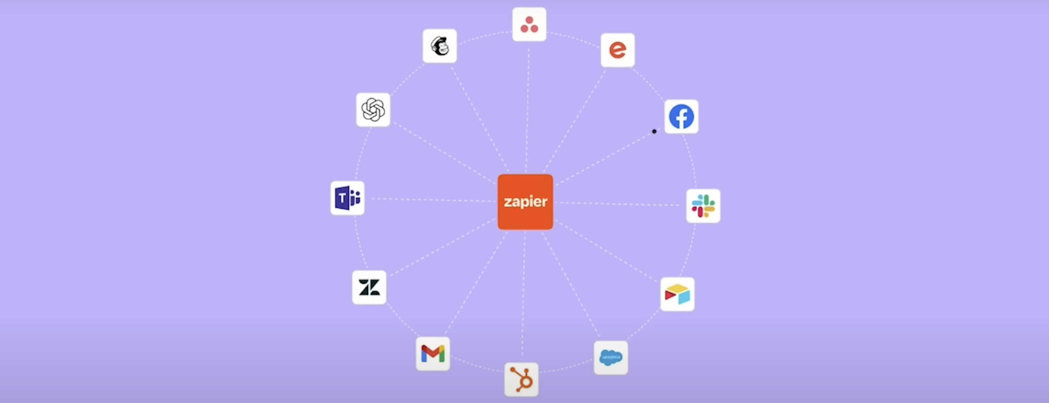
Advanced Prompting [Custom GPT Interactions]
Grimoire Prompt 1: Create a website using tailwind CSS about a coffee shop in NYC specialized in Italian Coffee
Grimoire Prompt 2: Send all this code to @DesignerGPT
DesignerGPT: Claim your Replit Project
Credits to Pietro Schirano
chatgpt.com

Slide 43

Part 3: Enhancing Data Workflows
Core Visualization
Statistical Visualization
Presentation Generation
Exploratory Data Analysis
Data Modeling
Data Limitations
Development Help

Slide 44
Core Visualization
Our Dataset: 2022-2023 S&P 500 dataset created from Yahoo Finance
Prompt: Using the provided dataset, create a Bar Chart of each company's values at the beginning the year.
Backend: By default, GPT using python on the backend
Tip(s):
Familiarize yourself with python libraries.
Use custom instructions.
Utilize the prompting techniques discussed
Understand GPT should enhance not replace
Visualization Guidelines: Tableau
chatgpt.com
Notes:
Ask GPT to the python visualization modules. Explain the differences with python modules. 1) Flip the x & y axis 2) Sort the chart 3) Tittle should be increased

Slide 45
Core Visualization
Pie Chart Prompt 1: Create a pie chart of the final values of all the companies.
Bar Chart- Prompt 2: Make a bar chart of the top 10 stocks to have increased in value from the beginning to end of the year. Include the initial value and final value. Show the percentage change for each company.
Line Chart- Prompt 3: Let’s visualize these same 10 companies as a timeseries chart.
Follow-up Let's visualize UNH. The lines should be green when at positive value and turn red when they lower in price.
chatgpt.com
Notes:
Pie charts, not so good for this case. Bar Charts are good for comparing groups. Line charts are a better representation of timeseries, for example this problem.

Slide 46

Statistical Visualizations
Prompt 1 (Histogram): Using the provided data, filter the dataset to only include 2022 data. Then create a histogram of our data using Seaborn. Overlay a Normal Distribution line and its metrics.
Prompt 2 (Boxplot): Let's create a box plot of the job titles.
Numerical Statistics: Let's perform some Job title statistics. Provide the results in a tabular format
Prompt 3 (Filtering): Let's create a histogram only using the Data Scientist job positions.
Prompt 4 (You can always ask): Can you compare salaries across experience levels?
Prompt 5 (Possibility for batch work): Examine our data for 2022 data science salaries. Explain the distribution and provide charts appropriate for your analysis.
chatgpt.com
Notes:
Normal Distribution vs Log-Normal Distribution

Slide 47
Power Point Generation
Prompt: Can you create a presentation based on this dataset, analysis and findings ?
NEW- ChatGPT PowerPoint Integration is now available for free.

Slide 48
Data Workflow
Our Case
Role Prompting: You are a Data Analyst employed to help with my work as a Data Scientist. You will always ask for confirmation before taking any further actions.
Our Opening Prompt:
Let’s deeply analyze the dataset provided. Tell me more about this dataset. For each column give me a brief description and any insights you notice.
Data Sourcing: Kaggle- Pima Indians Diabetes Database
Key Points
Applications in Data Analytics and Data Science:
Assists in data preprocessing, feature engineering, model development, evaluation, and deployment.
Capabilities:
Generates code snippets, explains statistical concepts, and provides actionable insights.
Example:
"How can I clean missing data in Python?" → ChatGPT generates code using pandas to handle missing values.
chatgpt.com
Notes:
Data workflow plays a crucial role in the field of data analytics and data science, aiding in various stages such as data preprocessing, feature engineering, model development, evaluation, and deployment. It offers capabilities such as generating code snippets, explaining statistical concepts, and providing actionable insights to users. For instance, when faced with the question 'How can I clean missing data in Python?', ChatGPT can efficiently provide code snippets using pandas to handle the missing values.
Utilizing data workflow tools like ChatGPT can streamline and enhance the data-related tasks for professionals, saving time and boosting productivity. These tools enable users to quickly tackle data challenges, gain valuable insights, and accelerate the overall data analytics process. Leveraging such advanced technologies can significantly benefit individuals and organizations working with data-driven applications in diverse domains.
By harnessing the power of data workflow tools, practitioners can efficiently navigate through complex data tasks, from basic data cleaning to advanced model deployment. These tools act as indispensable aids, empowering users with automation, resource optimization, and deeper understanding of data principles, ultimately leading to improved data-driven decision-making processes.

Slide 49
Exploratory Data Analysis
Our Case
Data Statistics: Provide me with the descriptive statics of the data. Please display the information as a table for me to interpret.
Data Visualization: Let’s visualize any outliners in out data.
Data Preprocessing: Let’s pre-process the data, what steps do you think we should take ? Provide me with a summary after each step.
Key Points
Data Statics: GPT can provide full data statistics.
Data Visualization: GPT can generate visualizations to make further decisions.
Data Pre-Processing:
ChatGPT assists in writing scripts to clean and preprocess data efficiently.
1) Missing Values 2) Scale Features 3) Data Imbalance 4) Feature Engineering 5) Encode Categorical Variables …
chatgpt.com
Notes:
Exploratory Data Analysis involves gaining initial insights and understanding of the data set.
Data Statistics are crucial for getting a comprehensive overview of the data. GPT can help provide detailed data statistics for thorough analysis.
Data Visualization is key for interpreting complex data. GPT can assist in generating visualizations to aid in decision-making processes.
Data Pre-Processing is essential for preparing data for modeling. ChatGPT can streamline this process by helping in tasks like handling missing values, scaling features, addressing data imbalance, performing feature engineering, and encoding categorical variables effectively.

Slide 50
Data Modeling & Limitations
Our Case
Data Modeling Suggestion: Let’s train a machine learning model. What are your top 10 model suggestions based on our dataset.
Multi-Model Reporting: Train all 5 models and report the results in a tabular format. Prioritize F1 scores.
Rework Data: Remove the outliers in our dataset. Then re-run the models and report back to me.
Hyper tunning: Limitation(s)
Key Points
Data Modeling : GPT can advise and ultimately choose models for our dataset. It can also
GUI GPT Limitations: Limitations can arise with environment tools, computational intensity and time-outs.
chatgpt.com
Notes:
In the context of data modeling, GPT can provide valuable advice on selecting models for datasets, streamlining the process. The limitations with GUI GPT tools can include challenges related to environmental factors, computational requirements, and potential time constraints. It's crucial to consider these limitations when utilizing GPT for data modeling tasks to ensure efficient and effective outcomes. Understanding these aspects can help in optimizing the use of AI tools for data analysis and decision-making.|

Slide 51
Moving Locally
Our Case
Data: Provide the data as a CSV file.
Source Code: Provide source code for both pre-processing and modeling steps.
Development Environment: Provide all terminal commands to create a virtual environment for this project.
Key Points
Downloadable Files: GPT can provide data, source code, visualizations for local development.
Local Environment: GPT could continue to assist users by creating virtual environments, debugging code or re-factoring source code after extensive development.
chatgpt.com
Notes:
When moving locally, utilizing GPT can offer various resources like data, source code, and visualizations to support your development process.
Additionally, GPT can assist in creating virtual environments, debugging code, and refactoring source code to enhance your local development experience.
Leverage the capabilities of GPT on chatgpt.com to streamline and improve your local development workflow.

Slide 52
Synthetic Data Generation
Our Case
Data: Provide the data as a CSV file (insurance.csv)
Purpose: Artificially supplement datasets using a CTGAN
Platform: gretel.ai
Key Points
ChatGPT Limitations: ChatGPT is great as a do-all platform but this comes with limitations. One of them being the programing environment.
Alternative Platforms: There are multiple platforms to handle specialized tasks.
chatgpt.com

Slide 53

Part 4: What’s Next
Prompting Frameworks
Specialized Gen AI Models
Privacy Concerns
What’s yet to come

Slide 54
Prompt Frameworks [Tree of Thoughts (ToT)]
Tree of Thoughts (ToT)
Definition: Tree of Thoughts (ToT) is an advanced NLP prompting technique that enhances reasoning by exploring multiple potential solutions or paths in a tree-like structure before converging on a final answer.
Key Features:
Exploration of Multiple Paths: Generates various potential solutions.
Hierarchical Structure: Organizes thoughts in a tree-like hierarchy.
Iterative Refinement: Evaluates and refines thoughts as it explores the tree.
Convergence on a Solution: Selects the most effective solution based on exploration.
Benefits:
Enhanced Reasoning: More thoughtful and accurate answers.
Thorough Exploration: Comprehensive examination of the problem space.
Better Decision-Making: Converges on the most effective solution.
Flexibility: Applicable to a wide range of tasks.
Applications:
Complex Problem Solving:
Task: Solve a multi-step mathematical problem.
Process: Explore different approaches, select the most efficient solution.
Strategic Planning:
Task: Develop a business strategy.
Process: Generate and evaluate multiple strategies, choose the best one.
Creative Writing:
Task: Write a novel with a complex plot.
Process: Explore various plot directions, select the most compelling narrative.
Decision Making:
Task: Make a critical business decision.
Process: Weigh different decision paths, select the optimal course of action.
chatgpt.com
Notes:
Tree of Thoughts (ToT) is an advanced NLP prompting technique that enhances reasoning by exploring multiple potential solutions or paths in a tree-like structure before converging on a final answer.
Key Features include the exploration of Multiple Paths, Hierarchical Structure, Iterative Refinement, and Convergence on a Solution, leading to Enhanced Reasoning, Thorough Exploration, Better Decision-Making, and Flexibility.
Applications of ToT span across Complex Problem Solving, Strategic Planning, Creative Writing, and Decision Making, each requiring a unique process of exploration, evaluation, and selection.

Slide 55
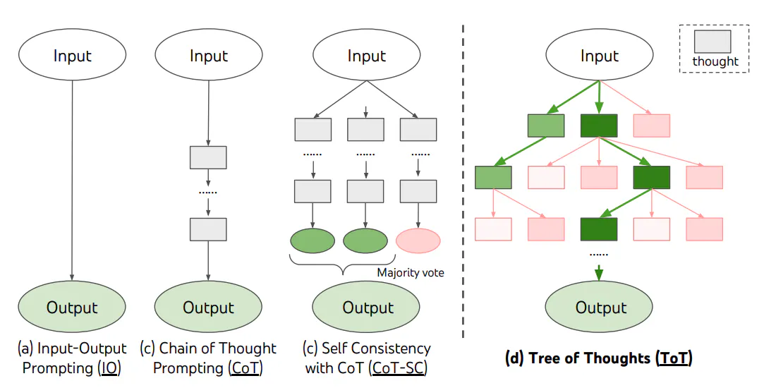
Prompt Frameworks Tree of Thoughts (ToT)
Tree of Thoughts: Deliberate Problem Solving with Large Language Models
chatgpt.com

Slide 56
Prompting Frameworks Smart GPT Framework
Smart GPT Prompting Framework
Definition: The Smart GPT Prompting Framework is an advanced technique designed to enhance the performance and accuracy of language models by employing a structured approach to generating, evaluating, and refining responses. Developed by AI Explained on YouTube, this framework focuses on iterative refinement, self-critique, and optimization to produce more reliable outputs.
Key Components:
Initial Response Generation: The model produces an initial response to the prompt.
Self-Reflection and Critique: The model evaluates its own response, identifying errors or areas for improvement.
Iterative Refinement: The response is refined through multiple iterations based on self-critique.
Parallel Response Generation: Multiple responses are generated and compared to identify the best output.
Response Selection and Optimization: The final response is selected and optimized for accuracy and relevance.
External Knowledge Integration: Incorporates external knowledge or tools to verify and enhance responses.
Benefits:
Improved Accuracy: Iterative refinement leads to more accurate outputs.
Enhanced Quality: Optimized for clarity, relevance, and effectiveness.
Better Handling of Complex Tasks: Structured approach aids in tackling complex problems.
Increased Confidence: Reflective process builds confidence in the model's responses.
Versatility: Applicable across various domains, from writing to problem-solving.
Applications:
Complex Problem Solving: Solve intricate problems with iterative reasoning.
Creative Content Generation: Produce high-quality creative content through multiple drafts.
Technical Documentation: Create accurate technical manuals with refined clarity.
Educational Content and Tutoring: Develop effective educational materials with improved explanations.
chatgpt.com
Notes:
The Smart GPT Prompting Framework is an advanced technique developed by AI Explained on YouTube to enhance language model performance and accuracy through structured approaches. It focuses on iterative refinement, self-critique, and optimization to produce reliable outputs. Key components include initial response generation, self-reflection, iterative refinement, parallel response generation, response selection, and external knowledge integration. Benefits of this framework include improved accuracy, enhanced quality, better handling of complex tasks, increased confidence, and versatility across various domains. Applications span from complex problem solving to creative content generation, technical documentation, and educational content creation and tutoring.

Slide 57
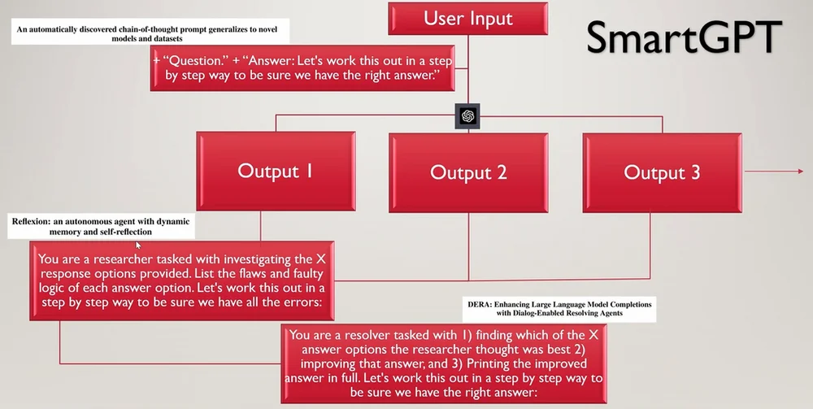
Prompting Frameworks [Smart GPT Prompting Framework]
Demonstration:
chatgpt.com

Slide 58
Beyond Scope Retrieval-Augmented Generation (RAG)
Retrieval-Augmented Generation (RAG)
Definition: RAG is an NLP technique that combines information retrieval with text generation to produce accurate and contextually relevant responses. The retrieval system finds relevant documents, and the generation model uses this information to generate a coherent output.
Key Features:
Combination of Retrieval and Generation: Integrates retrieval of relevant information with text generation.
Contextual Relevance: Ensures generated text is factually accurate and contextually appropriate.
Dynamic Knowledge Access: Accesses external information in real-time to enhance responses.
Improved Accuracy and Completeness: Leverages external data to produce more accurate and detailed content.
Benefits:
Enhanced Accuracy: Incorporates specific, up-to-date information.
Contextual Depth: Produces richer, more detailed responses.
Adaptability: Suitable for a wide range of domains and tasks.
Dynamic Updates: Incorporates the latest knowledge in real-time.
Applications:
Question Answering:
Task: Provide detailed answers using retrieved documents.
Example: Summarizing the latest advancements in quantum computing.
Content Generation:
Task: Generate informed articles or reports.
Example: Creating a report on climate change's impact on global agriculture.
Customer Support:
Task: Respond to customer inquiries accurately.
Example: Troubleshooting software issues using relevant help articles.
Research Assistance:
Task: Summarize complex topics for researchers.
Example: Analyzing studies on the economic impacts of artificial intelligence.
chatgpt.com

Slide 59
Beyond Scope Automatic Reasoning and Tool-use (ART)
Automatic Reasoning and Tool-use (ART)
Definition: Automatic Reasoning and Tool-use (ART) is an AI approach that integrates reasoning capabilities with the ability to use external tools or systems, allowing the AI to solve complex tasks by combining inference with dynamic data access and action execution.
Key Features:
Automatic Reasoning: Inference and decision-making capabilities for complex problem-solving.
Tool Integration: The ability to interact with and utilize external tools, databases, and APIs.
Combining Reasoning with Action: Iterative process of reasoning and executing tasks through tool-use.
Benefits:
Enhanced Problem-Solving: Solves more complex tasks by integrating reasoning with tool-use.
Dynamic Information: Accesses real-time data for more relevant decisions.
Increased Efficiency: Automates reasoning and tool-use for faster task execution.
Scalability: Applicable across various domains, making it highly versatile.
Applications:
Scientific Research:
Task: Solve complex scientific problems using simulations and data analysis.
Example: Hypothesizing and testing a new drug's effects using simulation tools.
Data Analysis and Reporting:
Task: Generate reports with real-time data.
Example: Compiling financial reports by reasoning about trends and retrieving current stock prices.
Customer Support:
Task: Provide automated support for complex inquiries.
Example: Resolving billing issues by reasoning through potential causes and accessing CRM data.
Automated Decision-Making:
Task: Make decisions based on dynamic data.
Example: Automated trading based on real-time market analysis.
chatgpt.com

Slide 60
Beyond Scope Automatic Prompt Engineer (APE)
Automatic Prompt Engineer (APE)
Definition: Automatic Prompt Engineer (APE) is a technique or system that automates the generation, optimization, and refinement of prompts for language models, enhancing the effectiveness of the models without manual prompt crafting.
Key Features:
Automated Prompt Generation: Creates prompts automatically based on tasks or requirements.
Prompt Optimization: Iteratively refines prompts for clarity and effectiveness.
Task-Specific Customization: Tailors prompts to the specific task for improved performance.
Performance Monitoring: Adjusts prompts based on feedback and model output.
Context Awareness: Considers the context of the task or query for appropriate prompts.
Benefits:
Increased Efficiency: Saves time by automating prompt generation.
Improved Accuracy: Enhances output quality through optimized prompts.
Task-Specific Adaptation: Tailors prompts to specific tasks for better results.
Scalability: Applicable across multiple domains and use cases.
Reduced Human Intervention: Allows non-experts to effectively use language models.
Applications:
Content Generation:
Task: Generate high-quality articles.
Example: APE creates prompts emphasizing key trends and applications in AI.
Customer Support:
Task: Automate responses to inquiries.
Example: APE generates prompts for detailed, relevant responses to customer queries.
Data Analysis and Reporting:
Task: Summarize complex data sets.
Example: APE prompts the model to highlight key trends and outliers in sales data.
Research Assistance:
Task: Summarize research findings.
Example: APE creates prompts focusing on recent advancements and challenges in renewable energy.
chatgpt.com

Slide 61
Beyond Scope Program-Aided Language Models (PAL)
Program-Aided Language Models (PAL)
Definition: Program-Aided Language Models (PAL) combine the natural language processing capabilities of language models with external programming tools to enhance problem-solving abilities, particularly for tasks requiring precise calculations, logical reasoning, or data handling.
Key Features:
Integration of Language Models and Programming: Combines generative language models with programming tools for complex task execution.
Enhanced Problem-Solving: Tackles problems that require precise calculations or logical reasoning.
Automated Execution of Programs: Language models generate code, which is executed to perform specific tasks.
Dynamic Interaction: Allows for iterative problem-solving through code generation and execution.
Benefits:
Enhanced Accuracy: Improved precision through programming tools.
Broader Problem-Solving: Extends the range of solvable problems.
Efficient Automation: Automates complex and repetitive tasks.
Dynamic and Interactive: Allows real-time, iterative problem-solving.
Scalability: Applicable across various domains, from research to software development.
Applications:
Mathematical Problem Solving:
Task: Solve complex mathematical problems.
Example: Generating and executing code to compute derivatives or integrals.
Data Analysis and Visualization:
Task: Analyze and visualize structured data.
Example: Creating a bar chart showing monthly sales from a dataset.
Automated Coding Assistance:
Task: Assist with coding tasks.
Example: Generating and testing a sorting algorithm based on a description.
Scientific Research:
Task: Perform simulations or data processing.
Example: Running simulations to study particle behavior in physics research.
chatgpt.com

Slide 62
Beyond Scope Multimodal Chain-of-Thought (CoT) Prompting
Multimodal Chain-of-Thought (CoT) Prompting
Definition: Multimodal Chain-of-Thought (CoT) Prompting is an NLP technique that extends the concept of sequential reasoning to tasks involving multiple modalities, such as text, images, audio, or video. It allows models to reason through complex tasks by integrating information from diverse sources, leading to richer and more contextually informed responses.
Key Features:
Sequential Reasoning Across Modalities: Integrates information from text, images, audio, and more in a step-by-step reasoning process.
Integration of Diverse Inputs: Combines various types of data to enhance understanding.
Enhanced Contextual Understanding: Achieves deeper contextual insights through multimodal reasoning.
Iterative Refinement: Allows for revisiting different modalities to refine responses.
Benefits:
Richer Responses: Provides more comprehensive and nuanced outputs.
Improved Accuracy: Cross-validates information across modalities.
Enhanced Interaction: Enables engaging and interactive experiences.
Versatility: Applicable across diverse domains, from healthcare to media production.
Scalable: Handles complex tasks involving multimodal data.
Applications:
Visual Question Answering (VQA):
Task: Answer questions about images by reasoning through visual and textual information.
Example: Analyzing an image of a person with an umbrella to explain why they are holding it.
Interactive Content Creation:
Task: Generate multimedia content by integrating text, images, and video.
Example: Creating a presentation on climate change using data, images of glaciers, and explanatory videos.
Medical Diagnosis Assistance:
Task: Assist in medical diagnosis by integrating patient data, images, and history.
Example: Analyzing an MRI and cross-referencing it with medical history to suggest diagnoses.
Educational Tools:
Task: Provide interactive learning by combining text, images, and videos.
Example: Teaching photosynthesis using diagrams, text explanations, and video demonstrations.
chatgpt.com

Slide 63

Claude 3.5 Sonnet: Overview and Applications
What is Claude 3.5 Sonnet? Claude 3.5 Sonnet is a state-of-the-art large language model developed by Anthropic AI. It stands out for its advanced problem-solving abilities, outperforming many leading AI models in areas like coding, reasoning, and visual data processing. This model is positioned as a versatile tool that excels in a variety of tasks, making it a strong competitor in the AI landscape.
Key Features and Use Cases:
Advanced Problem Solving: Claude 3.5 Sonnet excels in complex problem-solving tasks, including graduate-level reasoning and coding challenges. It has been benchmarked against top models and has shown superior performance in tasks that require deep logical reasoning and technical understanding.
Coding and Development: The model is highly effective as a coding assistant, capable of generating, debugging, and optimizing code efficiently. This makes it an invaluable tool for developers, automating tasks that typically require significant manual effort.
Visual and Multimodal Capabilities: Claude 3.5 Sonnet is particularly strong in visual reasoning, able to understand and create complex visual content such as graphs, charts, and simulations. It is also adept at handling multimodal tasks, where it processes and integrates both textual and visual data.
Education and Content Creation: The model can simplify complex concepts and create educational content, making it a powerful tool in academic and training environments. It’s also useful for generating presentations, documents, and other forms of content that require both textual and visual elements.
Why It Matters: Claude 3.5 Sonnet's combination of top-tier performance and cost-effectiveness could disrupt the AI industry, particularly in fields requiring sophisticated, real-time AI capabilities like automated software development, education, and visual data analysis. It offers a competitive edge by being both powerful and accessible, making advanced AI technology available to a broader range of users.
This model’s rapid ascent in industry benchmarks underscores its potential to become a cornerstone in various AI-driven applications, particularly where advanced reasoning, coding, and visual data processing are crucial.
Notes:
Claude 3.5 Sonnet, developed by Anthropic AI, is a state-of-the-art large language model known for its advanced problem-solving abilities, surpassing many leading AI models in coding, reasoning, and visual data processing. It is recognized for excelling in complex problem-solving tasks, including graduate-level reasoning and coding challenges, demonstrating superior performance in deep logical reasoning and technical understanding. The model serves as an efficient coding assistant, capable of generating, debugging, and optimizing code, automating tasks that typically demand significant manual effort. Its prowess extends to visual reasoning, enabling the understanding and creation of complex visual content like graphs, charts, and simulations. Claude 3.5 Sonnet is also adept at multimodal tasks, seamlessly processing and integrating textual and visual data. In education and content creation, it simplifies complex concepts, making it valuable in academic and training settings, as well as for generating presentations and documents that blend textual and visual elements. The model's high performance and cost-effectiveness position it to disrupt the AI industry, particularly in fields requiring real-time AI capabilities like automated software development, education, and visual data analysis. Its rapid rise in industry benchmarks indicates potential to become a cornerstone in various AI-driven applications, particularly those relying on advanced reasoning, coding, and visual data processing.

Slide 64

LLaMA 3.1: Overview & Use Cases
What is LLaMA 3.1?
LLaMA 3.1 is the latest open-source large language model developed by Meta, featuring up to 405 billion parameters.
It’s designed to rival top AI models like GPT-4, offering superior natural language processing (NLP) capabilities.
The model excels in reasoning, multilingual support (30+ languages), and extended context handling.
Key Use Cases:
Content Creation: Generates high-quality text, translations, and summaries, supporting long-form content and multilingual outputs.
Conversational AI: Enhances virtual assistants and chatbots with dynamic interaction capabilities and advanced function-calling features.
Code Generation: Automates coding tasks, generating secure and optimized code, aiding developers in software development.
Cross-Industry Applications: From customer support to technical documentation, LLaMA 3.1 is versatile across industries, handling complex queries and providing detailed analyses.
Why It Matters:
Open Source & Accessible: Allows developers and organizations to customize, deploy, and innovate without high costs.
Scalable & Efficient: Optimized for performance, making it suitable for both cloud-based and on-premises deployments.
This model is a game-changer in the AI landscape, offering powerful, flexible tools for a variety of applications, from content generation to complex problem-solving.
Notes:
LLaMA 3.1 is a cutting-edge large language model developed by Meta, boasting an impressive 405 billion parameters. This model aims to challenge renowned AI models like GPT-4 by offering enhanced natural language processing capabilities. It stands out in areas like reasoning, multilingual support for over 30 languages, and handling extended contextual information.
This model finds application in diverse areas such as content creation, conversational AI, code generation, and cross-industry applications. It excels in generating high-quality text, translations, and summaries, as well as enhancing virtual assistants and chatbots with advanced features. Additionally, it aids developers in coding tasks, while also being versatile across various industries.
The significance of LLaMA 3.1 lies in its open-source nature, allowing customization and deployment for developers and organizations without hefty costs. Its scalability and performance optimization make it suitable for both cloud-based and on-premises deployments. Overall, LLaMA 3.1 revolutionizes the AI landscape with its powerful tools for content generation and complex problem-solving.

Slide 65

Dataset Limitations & Security
Data Privacy and Security Concerns:
Data Transmission: ChatGPT processes data by sending it to a server where the model operates. This means that any data you input is transmitted over the internet, potentially exposing it to interception or unauthorized access.
Storage and Retention: OpenAI’s models, including ChatGPT, do not store personal data for long-term retention in a way that can be used to identify individuals. However, input data may still be logged temporarily for quality and debugging purposes, which could pose a risk when handling sensitive information.
Compliance with HIPAA:
Protected Health Information (PHI): HIPAA defines strict rules for how PHI must be handled, including requirements for data encryption, access control, and audit trails. ChatGPT, as a public AI model, is not HIPAA-compliant and cannot be used to process, store, or transmit PHI without violating these regulations.
Business Associate Agreements (BAA): Under HIPAA, entities that handle PHI must have a BAA with any third-party service provider that processes PHI on their behalf. Since OpenAI does not offer BAAs for ChatGPT, using it with HIPAA-regulated data would be non-compliant.
Confidential Research Data:
Non-Disclosure Agreements (NDAs) and Data Use Agreements (DUAs): Many research projects involve agreements that restrict how data can be shared and with whom. Using ChatGPT to process confidential research data could breach these agreements if the terms prohibit sharing data with external services.
Risk of Unintended Disclosure: There’s a risk that sensitive data input into ChatGPT could be inadvertently exposed to unauthorized parties through the model’s responses or via potential breaches in the service’s security.
Notes:
Data privacy and security concerns play a crucial role in the usage of ChatGPT, as data input is transmitted over the internet, potentially exposing it to interception or unauthorized access. While OpenAI's models do not store personal data for long-term retention, input data may be logged temporarily for quality and debugging purposes, posing risks with sensitive information handling. Compliance with HIPAA regulations is essential for handling Protected Health Information (PHI), and ChatGPT is not HIPAA-compliant, making it non-compliant for processing, storing, or transmitting PHI. Using ChatGPT for processing confidential research data could breach agreements like Non-Disclosure Agreements (NDAs) and Data Use Agreements (DUAs), as there's a risk of unintended disclosure through the model's responses or potential security breaches.

Slide 66

Ethical Considerations
Ethical and Legal Considerations:
Informed Consent: Researchers must ensure that participants in studies involving personal data have given informed consent for their data to be used. Using an AI service like ChatGPT could violate this consent if participants were not informed that their data would be processed by an external AI system.
Data Anonymization: Even if data is anonymized before being input into ChatGPT, there remains a risk of re-identification, especially if the AI model generates outputs that could indirectly reveal sensitive information.
Recommendations for Researchers:
Avoid Using ChatGPT for Sensitive Data: Do not input any data that could be considered PHI, confidential research data, or any information protected under privacy laws into ChatGPT.
Use Secure, Compliant Tools: Opt for tools and platforms specifically designed to comply with HIPAA and other data protection regulations when handling sensitive information.
Consult Legal and Compliance Teams: Before using any AI tool for research, especially with sensitive data, consult your institution’s legal and compliance teams to ensure that your data handling practices meet all relevant regulatory requirements.
Notes:
Researchers must prioritize obtaining informed consent from participants before using personal data in studies, ensuring transparency and ethical practices in data processing. Utilizing AI services like ChatGPT raises concerns around violating consent if participants are unaware of data processing by external systems. Data anonymization may not fully eliminate re-identification risks, especially if AI outputs inadvertently disclose sensitive details. Researchers are advised to avoid inputting sensitive data into ChatGPT, opt for secure platforms compliant with data protection laws, such as HIPAA, and seek guidance from legal and compliance teams to uphold regulatory requirements when handling confidential information.

Slide 67
U-M GPT
Introduction to UM-GPT
Definition & Purpose: Custom language model for U-M
Development: Tailored for education & research
Core Features & Capabilities
Specialized Knowledge: Focused on U-M academic areas
Academic Integration: Aligned with university systems
Applications of UM-GPT
Educational Use: Course content creation, student support
Research Support: Data analysis, hypothesis testing
Administrative Tasks: Automating routine operations
Ethical Considerations
Data Privacy: Strong compliance measures
Ethical AI Usage: Adheres to U-M standards
Future Developments
Upgrades & Expansion: New features and academic areas
Collaboration: Opportunities with other institutions
Impact & Conclusion
Enhancing Education & Research: Improving productivity
Vision: The future of UM-GPT in academia
Notes:
Ensuring data privacy is crucial in our ethical considerations, with strong compliance measures in place to protect sensitive information. When it comes to AI usage, our approach adheres to U-M standards to maintain ethical practices. In terms of future developments, we are focused on upgrades and expansion, introducing new features and academic areas to enhance our offerings. Collaboration is also a key focus, presenting opportunities for partnerships with other institutions to drive innovation. The impact of our efforts is aimed at enhancing education and research, ultimately improving productivity within the academic community. Looking ahead, our vision for UM-GPT in academia is geared towards shaping the future of learning and research through cutting-edge technologies.

Slide 68
Gen AI for Data Science
These platforms are top-tier choices for data scientists and organizations looking to leverage AI for advanced data analysis, model development, and deployment. Each offers robust features tailored to various aspects of the data science process.
DataRobot:
Description: A comprehensive AI-driven platform that automates the entire data science workflow, from data preparation to model deployment. It uses AutoML to generate predictive models, evaluate them, and provide actionable insights.
Best For: Enterprises and data scientists looking to automate and scale their data science projects with minimal manual intervention.
H2O.ai:
Description: An open-source AI platform known for its AutoML capabilities, H2O.ai provides tools for data preprocessing, model training, and deployment. It supports a wide range of algorithms and is widely used in predictive analytics and machine learning.
Best For: Data scientists and developers needing a robust platform for building and deploying machine learning models with advanced automation features.
Google Cloud AutoML:
Description: A suite of machine learning products within Google Cloud that enables developers with limited ML expertise to train high-quality models. AutoML covers a range of tasks from image recognition to natural language processing.
Best For: Organizations looking to quickly develop and deploy custom machine learning models without needing extensive machine learning expertise.
IBM Watson Studio:
Description: A collaborative environment that brings together tools for data preparation, machine learning, and AI model management. Watson Studio integrates with IBM's broader AI ecosystem, offering both automated and manual data science tools.
Best For: Large teams and enterprises that need a powerful, collaborative platform for building, training, and deploying data science models.
Azure Machine Learning:
Description: A cloud-based platform that offers a full suite of machine learning tools, including AutoML, model training, and deployment. Azure ML is highly scalable and integrates seamlessly with other Microsoft Azure services.
Best For: Enterprises and data scientists who require a scalable, cloud-based environment for developing and deploying data science models within the Azure ecosystem.

Slide 69

Gen AI for Programming
Here are the top 5 Generative AI models for programming:
GitHub Copilot:
Description: An AI-powered coding assistant created by GitHub and OpenAI. It provides real-time code suggestions, autocompletion, and can even generate entire functions or classes based on comments and code context.
Best For: Developers looking for seamless integration with popular IDEs like Visual Studio Code and those who want to speed up their coding process while reducing errors.
Codex by OpenAI:
Description: A versatile AI model that translates natural language instructions into code. It supports multiple programming languages and can generate anything from small code snippets to full-fledged applications.
Best For: Automating code generation from natural language, especially in multi-language projects, and aiding in software development.
Tabnine:
Description: A deep learning-powered code completion tool that integrates with various IDEs. It provides context-aware suggestions and can predict the next lines of code, helping to accelerate coding productivity.
Best For: Developers who need reliable code completion across multiple programming languages, with a focus on speeding up coding tasks.
AlphaCode by DeepMind:
Description: A sophisticated AI model designed to solve complex programming problems. It excels in competitive programming, generating solutions to algorithmic challenges.
Best For: Competitive programmers and those tackling difficult coding challenges requiring algorithmic solutions.
Kite:
Description: An AI-driven code completion tool that offers intelligent suggestions in real-time. It is lightweight and integrates smoothly with many popular IDEs.
Best For: Developers seeking a user-friendly code completion tool that supports languages like Python and JavaScript, enhancing productivity with minimal setup.

Slide 70

Gen AI for Images
Here are some top Generative AI models and tools specialized for images:
DALL-E by OpenAI:
Description: A powerful AI model that generates highly detailed and creative images from textual descriptions. It can create complex scenes, objects, and even stylized art.
Best For: Artists, designers, and content creators who want to quickly generate unique images based on specific prompts.
MidJourney:
Description: An AI tool focused on generating artistic and imaginative images from text prompts. It produces high-quality, stylized visuals that are often surreal or abstract.
Best For: Artists and digital creators looking for inspiration or those who want to produce art with minimal input.
DeepArt:
Description: An AI platform that transforms photos into artwork in the style of famous painters. It uses deep learning to apply various artistic styles to images.
Best For: Creating art pieces or stylized photos in the likeness of well-known painting styles.
Artbreeder:
Description: A collaborative AI tool that allows users to blend and evolve images to create unique art. It’s popular for generating character designs, landscapes, and abstract art.
Best For: Artists and designers who want to explore and experiment with new visual concepts.
Runway ML:
Description: Offers a variety of creative AI tools, including image generation and manipulation. It is particularly useful for creating generative art, and style transfer, and experimenting with visual effects.
Best For: Artists, designers, and media professionals looking to incorporate AI into their creative workflows.

Slide 71

Gen AI for Music Creation
These AI tools are designed to assist with various aspects of music creation, from composing and arranging to generating entirely new and unique music tracks.
Magenta by Google:
Description: An open-source research project that explores the role of machine learning in the creative process, focusing on music and art generation. Magenta offers tools like NSynth (a neural synthesizer) and MusicVAE (a variational autoencoder for generating melodies and rhythms).
Best For: Musicians, composers, and researchers interested in exploring AI-generated music and creating new sounds.
Amper Music:
Description: An AI-driven music composition tool that allows users to create custom, royalty-free music tracks by selecting the style, mood, and instruments. It uses AI to compose music that fits the user’s specifications.
Best For: Content creators, filmmakers, and marketers who need quick, customizable music tracks for their projects.
AIVA (Artificial Intelligence Virtual Artist):
Description: AIVA is an AI composer capable of creating emotional and complex music, often used for film scores, video games, and other multimedia content. It can compose music in various styles and genres.
Best For: Composers, music producers, and content creators who need high-quality music compositions generated by AI.
OpenAI Jukebox:
Description: A neural network that generates music, including raw audio in a variety of genres and artist styles. Jukebox can create full songs with singing, instrumentation, and lyrics based on the input it receives.
Best For: Musicians and experimenters looking to create new music styles, remix existing music, or explore AI-driven music creation.
Soundraw:
Description: An AI music generator that allows users to create original music by choosing mood, genre, and length. It provides a seamless interface for generating and customizing music to fit specific project needs.
Best For: Creators, video editors, and developers who need customizable background music for videos, games, and other media.

Slide 72

Gen AI for Videos
Here are some top Generative AI models and tools specialized for video:
DALL-E by OpenAI
Description: In addition to image generation, Runway ML provides tools for real-time video editing, video synthesis, and generating new video content using AI.
Best For: Filmmakers, video editors, and content creators who want to incorporate AI-driven effects and video generation into their projects.
Synthesia:
Description: A video generation platform that uses AI to create videos with realistic avatars speaking in multiple languages. It’s widely used for creating training videos, corporate content, and educational materials.
Best For: Businesses and educators needing quick, scalable video content production without a large production team.
DeepArt Video:
Description: Extends the capabilities of DeepArt to video, applying artistic styles to video frames, transforming them into moving art pieces.
Best For: Video creators and artists looking to stylize video content with artistic effects.
Pictory:
Description: An AI tool that transforms text content into short videos. It can create engaging videos for social media, blogs, and marketing by analyzing text and adding relevant visuals and audio.
Best For: Content marketers and social media managers who need to quickly generate video content from text-based sources.
Lumen5:
Description: A video creation platform that turns blog posts and articles into engaging videos using AI. It automates the video creation process by selecting relevant visuals, animations, and music.
Best For: Marketers, content creators, and businesses looking to repurpose written content into video format.

Slide 73

Understanding Grokking in AI Models
Definition: Grokking refers to a model's transition from simple memorization to a deeper understanding of a concept.
Example:
Training Set Performance (Red): The model initially memorizes and performs perfectly on the exact divisions it was trained on.
Validation Set Performance (Green): The model struggles with unseen division tasks, showing it hasn't understood the concept.
Extended Training: After around 100,000 training steps, the model begins to understand division, showing improved performance on unseen tasks.
Final Outcome: By one million training steps, the model achieves nearly 100% accuracy, demonstrating it has "grokking" the concept of division.
Importance: This process is crucial for developing AI models that can generalize concepts and perform well on new, unseen data, moving beyond mere memorization.
Notes:
Grokking in AI models involves a transition from memorization to true understanding of concepts. Initially, the model excels at tasks it's been trained on, as seen in the perfect performance on the training set. However, when faced with new tasks in the validation set, it struggles to generalize, highlighting the need for deeper comprehension. Through extended training steps, typically around 100,000, the model slowly grasps the concept, leading to improved performance on unseen tasks. The ultimate goal is achieved after approximately one million training steps, where the model showcases nearly perfect accuracy, showcasing its 'grokking' of the concept. This process is critical for AI models to generalize effectively and excel with new data, emphasizing the importance of moving beyond mere memorization.

Slide 74
Emergent Behaviors in Large Language Models
Definition: Emergent behaviors refer to new abilities that large language models acquire suddenly as they scale up in size.
Key Paper: "The Emergent Abilities of Large Language Models" by Google, which popularized the term emergent behaviors.
Observations:
Critical Scale: Performance on tasks like translation, arithmetic, and logic remained flat until the model reached a particular scale, after which it spiked sharply, indicating the emergence of new abilities.
Significance: This phenomenon suggests that scaling models can unlock new capabilities, making it a critical consideration for AI development.
Notes:
Emergent behaviors in large language models refer to sudden new abilities acquired as models scale up in size.
The key paper by Google, 'The Emergent Abilities of Large Language Models,' popularized the term emergent behaviors.
Performance on tasks like translation, arithmetic, and logic remains flat until the model reaches a critical scale, after which new abilities sharply emerge.
This phenomenon highlights how scaling models could unlock new capabilities, a critical consideration for AI development.

Slide 75
Debating the Reality of Emergent Behaviors
Controversy: Some researchers argue that these emergent behaviors might be artifacts of the metrics used rather than fundamental changes in model behavior.
Metric Analysis:
The original paper used discontinuous metrics, like exact string match or multiple-choice grades, which can give either full credit or none, potentially obscuring incremental improvements.
Alternative Metrics: The critique suggests using continuous metrics, like Token Edit Distance, which provide partial credit for nearly correct answers, leading to smoother, more predictable performance improvements.
Implications: This debate underscores the importance of metric selection in AI research, as it can dramatically alter the interpretation of a model's capabilities.
Notes:
Some researchers argue that emergent behaviors may not be true changes in model behavior but artifacts of the metrics used. The original paper employed discontinuous metrics, such as exact string match or multiple-choice grades, which could obscure incremental improvements. An alternative approach suggests using continuous metrics like Token Edit Distance to provide partial credit for nearly correct answers, leading to smoother performance improvements. This debate highlights the critical role of metric selection in AI research, as it can significantly impact how a model's capabilities are perceived.

Slide 76
The Mathematical Perspective on Emergence and Grokking
Task Completion Probability: A key graph demonstrated how increasing the probability of success in each step of a task dramatically improves the likelihood of overall task success.
Mathematical Explanation: As the probability of success in individual steps increases from 90% to 99.9%, the overall usefulness of the model can leap from being practically useless to world-changing.
Subjectivity: While the concept of emergence might seem subjective, it is often rooted in solid mathematical reasoning.
Impact: This perspective is vital for advancing AI models and understanding their sudden leaps in capability, which can be mathematically predictable even if they appear unexpected.
Notes:
Increasing the probability of success in each step of a task can significantly enhance the overall likelihood of task success.
Exploring the mathematical perspective, a shift from 90% to 99.9% success rate in individual steps can transform a model's utility from negligible to transformative.
Although emergence may appear subjective, it is often supported by robust mathematical foundations.
Understanding the impact of this concept is crucial in advancing AI models and deciphering their sudden advancements, which can be predicted mathematically despite seeming unforeseen.

Slide 77
AI Takeoff Speeds
Key Question: How quickly might AI progress from human-level intelligence to superintelligence? This central debate has profound implications for global stability, ethics, and governance.
Defining and Differentiating AI Takeoff Scenarios
Takeoff Definition: The takeoff phase starts when AI reaches human-level intelligence and ends when it becomes a superintelligence, surpassing the collective intelligence of humanity.
Human Baseline: Typically defined as an AI performing at the level of a typical human worker, though "typical human intelligence" is a debated and complex concept, involving emotional, social, and creative dimensions.
Superintelligence: An AI that can replicate the output of all humanity, though this remains a broad and debated definition. Some argue that superintelligence should also include capabilities like innovation, governance, and empathy.
Slow Takeoff vs. Fast Takeoff:
Slow Takeoff: A gradual transition from human-level AI to superintelligence taking more than a year, allowing for societal adaptation and incremental change, similar to the adoption of electricity or the internet.
Fast Takeoff: A rapid transition occurring in less than a year, possibly within minutes or hours, leading to concerns that societal, economic, and governmental responses may lag behind technological advancements.
Notes:
The debate surrounding the speed of AI progression from human-level intelligence to superintelligence carries significant implications for global stability, ethics, and governance.
The takeoff phase of AI is defined as starting at human-level intelligence and ending at superintelligence, surpassing the collective intelligence of humanity.
Human baseline intelligence in AI is often compared to that of a typical human worker, although the concept of "typical human intelligence" remains complex, encompassing emotional, social, and creative aspects.
Superintelligence is described as an AI capable of replicating the output of all humanity, with ongoing debates on whether it should also encompass traits like innovation, governance, and empathy.
The distinction between slow takeoff and fast takeoff scenarios lies in the gradual versus rapid transition from human-level AI to superintelligence, with implications for societal adaptation, economic responses, and governance mechanisms.

Slide 78
Key Perspectives on AI Takeoff
OpenAI's Position: OpenAI prefers a slow takeoff, advocating for societal adaptation, regulation, and ethical development to co-evolve with AI, preventing sudden and uncontrollable changes.
Sam Altman’s View: The CEO of OpenAI expects a short timeline to human-level AI, followed by a slow takeoff to superintelligence. He emphasizes the importance of cautious AI deployment and the role of definitions in predictions.
Contrasting Views: Some experts, like Eliezer Yudkowsky, argue for the likelihood of a fast takeoff due to recursive self-improvement, potentially leading to an intelligence explosion that outpaces human oversight.
Notes:
OpenAI advocates for a gradual approach to AI development to allow for societal adaptation, regulation, and ethical considerations, aiming to prevent sudden and uncontrollable changes.
Sam Altman, the CEO of OpenAI, predicts a short timeline to human-level AI, followed by a slow transition to superintelligence. He stresses the need for careful deployment of AI and the significance of defining terms in predictive models.
On the other hand, experts like Eliezer Yudkowsky argue that rapid advancements in AI, particularly through recursive self-improvement, could result in an intelligence explosion surpassing human oversight, suggesting a faster takeoff scenario.

Slide 79
Government, Industry Debates, and Safety Measures
Paul Christiano's Analysis: Christiano suggests that a slow takeoff is more likely, with a framework that predicts early signs of AI’s impact, allowing society time to adapt before AI reaches superintelligence.
Human-Chimp Analogy: This analogy illustrates how minor increases in intelligence could lead to significant leaps in capabilities, with potential to destabilize societal structures.
OpenAI's Preparedness Framework: OpenAI has safety thresholds to prevent a fast takeoff, including halting development if a model reaches a critical safety risk level. These measures are designed to address scenarios where AI might gain excessive capabilities, such as autonomous self-improvement or manipulation of public opinion.
Ethical Considerations: Beyond technical safety measures, ethical concerns like exacerbation of social inequalities and disruption of democratic processes are integrated into AI development, ensuring broader societal impacts are considered.
Notes:
Paul Christiano suggests a gradual emergence of AI's impact, offering a time window for societal adaptation before AI achieves superintelligence.
The Human-Chimp Analogy showcases how small intelligence boosts can lead to significant advancements, potentially disrupting societal structures.
OpenAI's Preparedness Framework includes safety thresholds to prevent rapid AI advancement, such as ceasing development if models pose critical safety risks. These precautions address scenarios like autonomous self-enhancement and public opinion manipulation.
Ethical aspects like exacerbation of social disparities and interference with democratic processes are intrinsic to AI development, ensuring broad societal consequences are taken into account.

Slide 80
Implications and Conclusion
Implications of Slow vs. Fast Takeoff:
Slow Takeoff: Allows time for societal adaptation, international cooperation, and the development of regulatory frameworks. However, challenges include achieving global consensus and the risk of uneven adaptation, potentially widening global inequalities.
Fast Takeoff: Presents significant risks, with little time to react and potential ethical dilemmas, including the loss of human agency and concentration of power. The role of AI governance becomes crucial, with the need for preemptive measures to align AI development with human values.
Key Takeaway: Understanding the concepts of slow and fast takeoff is crucial as they have significant implications for the future of society. These terms are central to ongoing debates in AI development and require informed engagement from both industry and government stakeholders.
Final Thought: Regardless of personal opinions on AI takeoff scenarios, staying informed about these debates is essential.
Notes:
Understanding the implications of slow vs. fast takeoff in the context of AI development is essential for societal adaptation and regulatory frameworks. While a slow takeoff allows time for international cooperation and consensus building, challenges may arise in achieving global alignment and addressing potential inequalities. On the other hand, a fast takeoff presents immediate risks, including ethical dilemmas like loss of human agency and power concentration. The discussion on AI governance becomes pivotal in ensuring alignment with human values. It is crucial for both industry and government stakeholders to engage in informed debates on these concepts. Regardless of personal opinions, staying informed on AI takeoff scenarios is crucial. Reflecting on the future implications of AI development speeds can foster deeper engagement with the topic and encourage proactive consideration of potential futures shaped by AI advancements.

